Slide 1
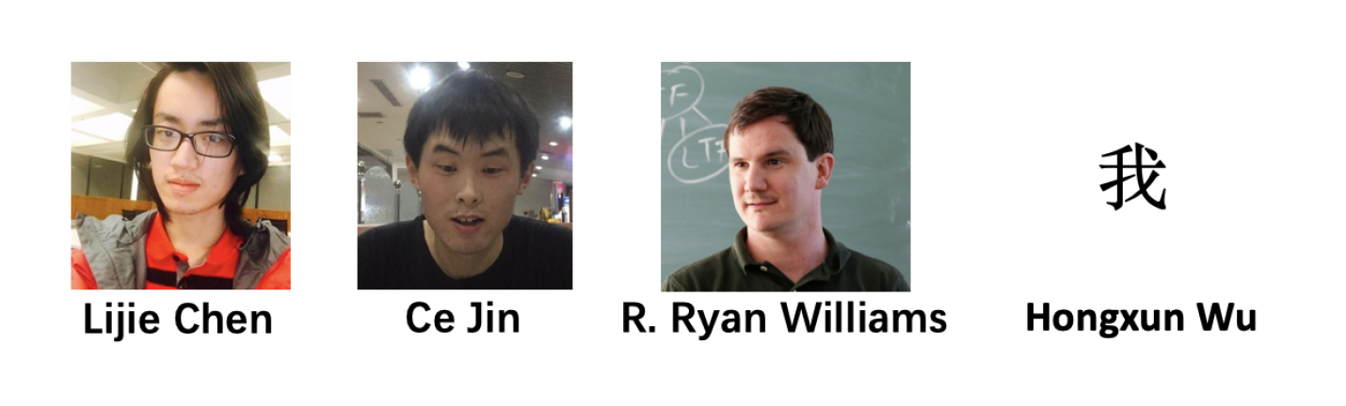

Truly Low-Space Element Distinctness and Subset Sum via Pseudorandom Hash Functions
UC Berkeley
MIT
MIT
UC Berkeley
Some figures are from Hongxun’s previous slides

Slide 2
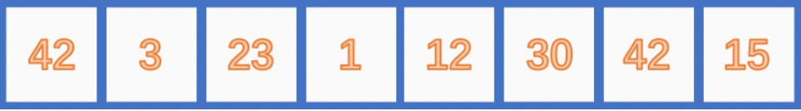
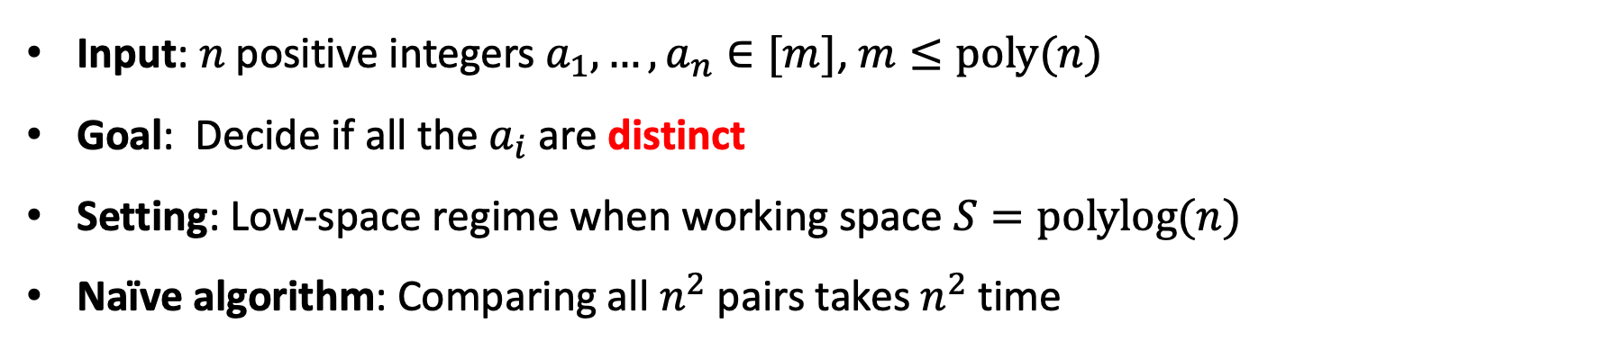
Today’s Problem: Element Distinctness
Read-only
Input: $n$ positive integers $a_{1},…,a_{n}∈[m]$, $m≤poly(n)$
Goal: Decide if all the $a_{i}$ are distinct
Setting: Low-space regime when working space $S=polylog(n)$
Naïve algorithm: Comparing all $n^{2}$ pairs takes $n^{2}$ time

Slide 3
Today’s Plan
Part I (Background and Our Results)
Part II (Proof Overview)

Slide 4
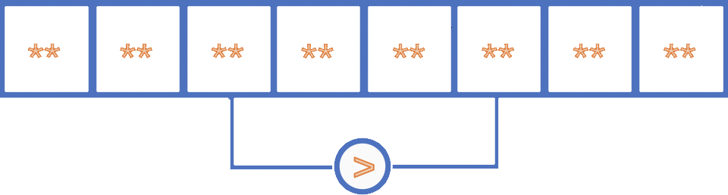
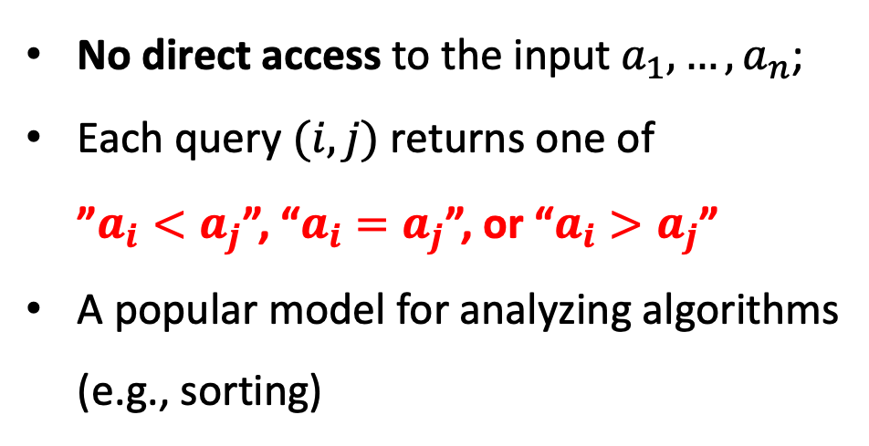
Previous Work in the Comparison Model
No direct access to the input $a_{1},…,a_{n}$;
Each query $(i,j)$ returns one of
”$a_{i}<a_{j}$”, “$a_{i}=a_{j}$”, or “$a_{i}>a_{j}$”
A popular model for analyzing algorithms
(e.g., sorting)
Theorem
(Borodin et al., 1987) (Yao, 1988)
When space S = O(polylog n), Element Distinctness requires T ≥ n^{2−o(1)} time in the comparison model.
More generally, TS ≥ n^{2−o(1)} (Yao, 1988).

Slide 5
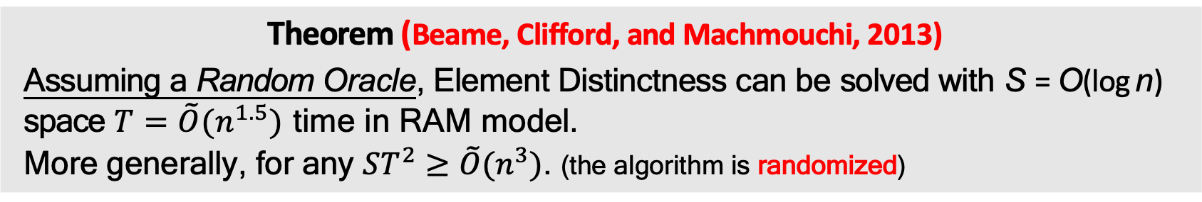
Previous Work in the RAM Model
Read-only
Random access to read-only input. Allow arbitrary arithmetic and bit operations.
Theorem (Beame, Cliﬀord, and Machmouchi, 2013)
Assuming a Random Oracle, Element Distinctness can be solved with S = O(log n) space $T=\tilde{O}(n^{1.5})$ time in RAM model.
More generally, for any $ST^{2}≥\tilde{O}(n^{3})$. (the algorithm is randomized)

Slide 6
Previous Work in the RAM Model
Read-only
Random access to read-only input. Allow arbitrary arithmetic and bit operations.
Theorem (Beame, Cliﬀord, and Machmouchi, 2013)
Assuming a Random Oracle, Element Distinctness can be solved with S = O(log n) space $T=\tilde{O}(n^{1.5})$ time in RAM model.
More generally, for any $ST^{2}≥\tilde{O}(n^{3})$. (the algorithm is randomized)

Slide 7
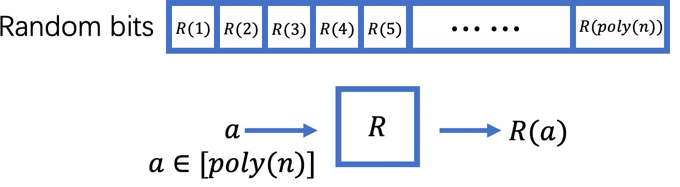
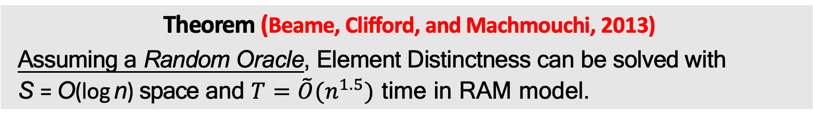
The Random Oracle Assumption
Theorem (Beame, Cliﬀord, and Machmouchi, 2013)
Assuming a Random Oracle, Element Distinctness can be solved with
S = O(log n) space and $T=\tilde{O}(n^{1.5})$ time in RAM model.
The algorithm need random access to poly(n) random bits that do not count into the space complexity.

Slide 8
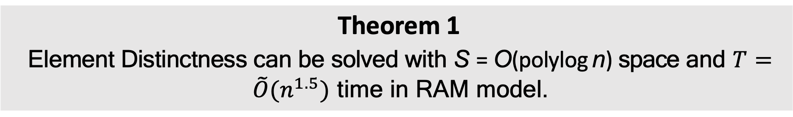
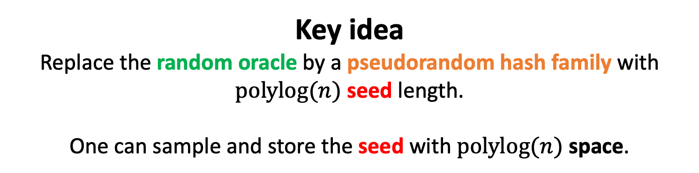
Our Results I
Theorem 1
Element Distinctness can be solved with S = O(polylog n) space and $T=\tilde{O}(n^{1.5})$ time in RAM model.
Key idea
Replace the random oracle by a pseudorandom hash family with $polylog(n)$ seed length.
One can sample and store the seed with $polylog(n)$ space.

Slide 9
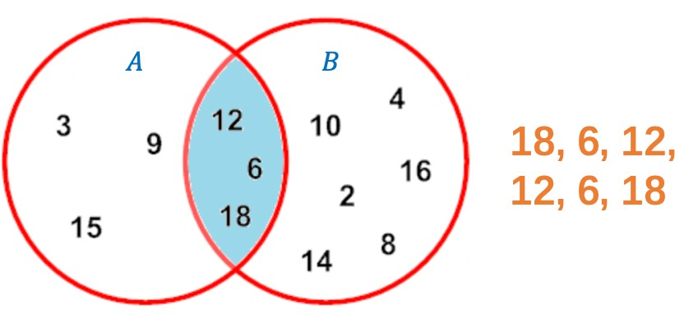
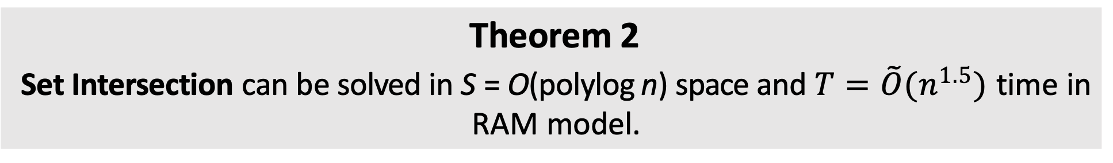
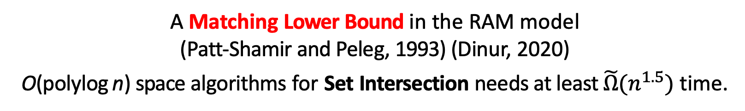
Our Results II: Set Intersection
Set Intersection
Given two integer sets A, B, print all the elements in
A ∩ B in any order. Each element is allowed to be printed multiple times.
Theorem 2
Set Intersection can be solved in S = O(polylog n) space and $T=\tilde{O}(n^{1.5})$ time in RAM model.
A Matching Lower Bound in the RAM model
(Patt-Shamir and Peleg, 1993) (Dinur, 2020)
O(polylog n) space algorithms for Set Intersection needs at least $\tilde{Ω}(n^{1.5})$ time.

Slide 10
Our Results III: Subset sum
Subset Sum: Given n integers a₁, a₂, . . . , a_{n} and target t, decide whether a subset of them sum up to t.
Low-space Subset Sum (Bansal, Garg, Nederlof, and Vyas, 2017)
Assuming a Random Oracle, Subset Sum and Knapsack can be solved by a Monte Carlo algorithm in 2^{0.87n} time with O(poly(n)) space.
Theorem 3
Subset Sum and Knapsack can be solved by a Monte Carlo algorithm in 2^{0.87n} time with O(poly(n)) space.

Slide 11
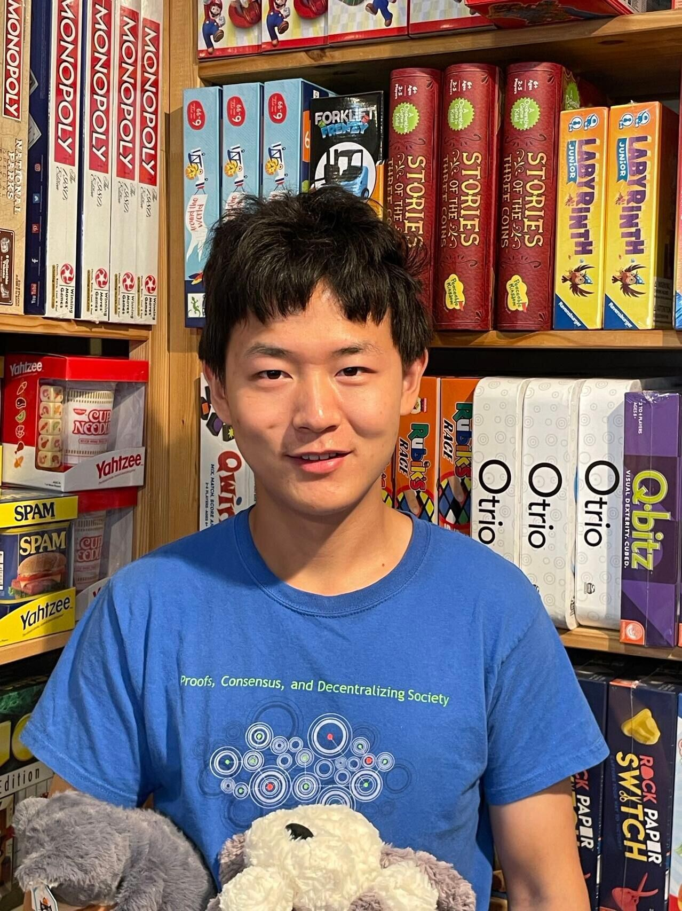
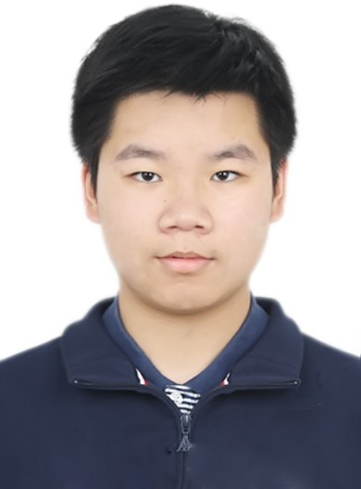
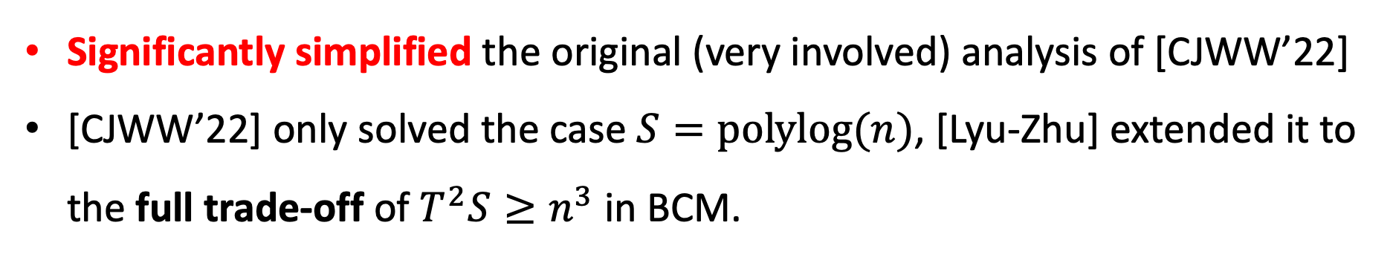
An Important Follow-up Work by Lyu and Zhu
Significantly simplified the original (very involved) analysis of [CJWW’22]
[CJWW’22] only solved the case $S=polylog(n)$, [Lyu-Zhu] extended it to the full trade-off of $T^{2}S≥n^{3}$ in BCM.
In the rest of talk, I will present
the simplified analysis by Lyu and Zhu
Xin Lyu (UC Berkeley)
Weihao Zhu
(Shanghai Jiaotong University)

Slide 12
Today’s Plan
Part I (Background and Our Results)
Part II (Proof Overview)
  Recap of the BCM algorithm
  Construction of the pseudorandom hash family
  A Communication Perspective of the pseudorandom walk
  An idealized analysis
  Coupling and subtract the overcount

Slide 13
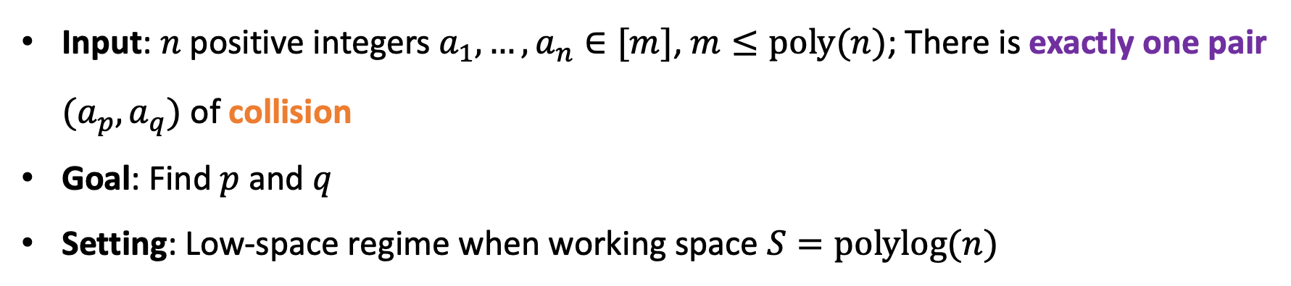
Element Distinctness: The Hardest Case
Read-only
Input: $n$ positive integers $a_{1},…,a_{n}∈[m]$, $m≤poly(n)$; There is exactly one pair $(a_{p},a_{q})$ of collision
Goal: Find $p$ and $q$
Setting: Low-space regime when working space $S=polylog(n)$

Slide 14
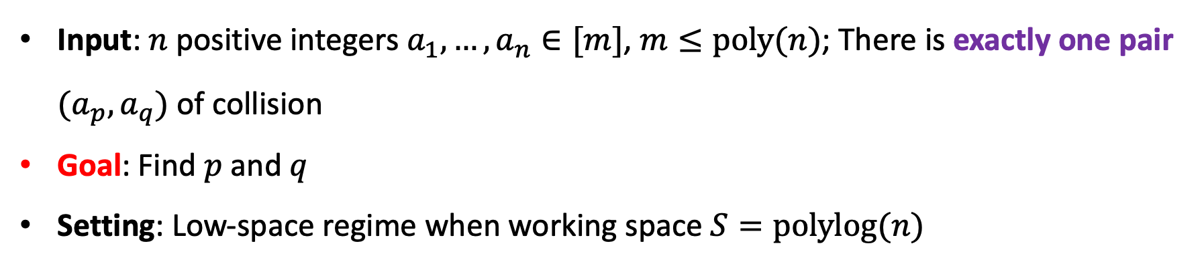
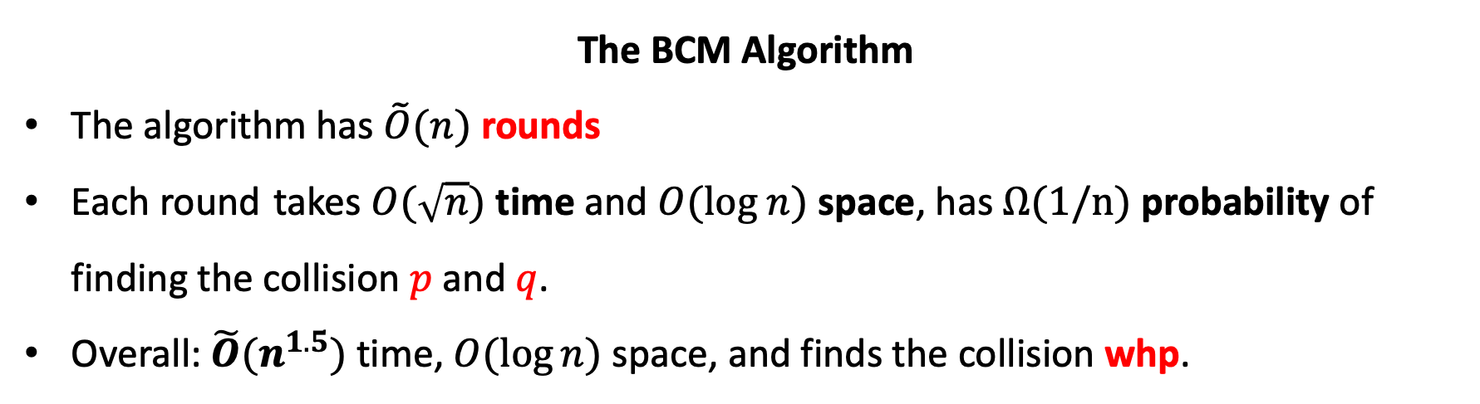
Recap of the BCM Algorithm: High-level
Input: $n$ positive integers $a_{1},…,a_{n}∈[m]$, $m≤poly(n)$; There is exactly one pair $(a_{p},a_{q})$ of collision
Goal: Find $p$ and $q$
Setting: Low-space regime when working space $S=polylog(n)$
The BCM Algorithm
The algorithm has $\tilde{O}(n)$ rounds
Each round takes $O(\sqrt{n})$ time and $O(log n)$ space, has $Ω(1/n)$ probability of finding the collision $p$ and $q$.
Overall: $\tilde{O}(n^{1.5})$ time, $O(\log{n})$ space, and finds the collision whp.

Slide 15
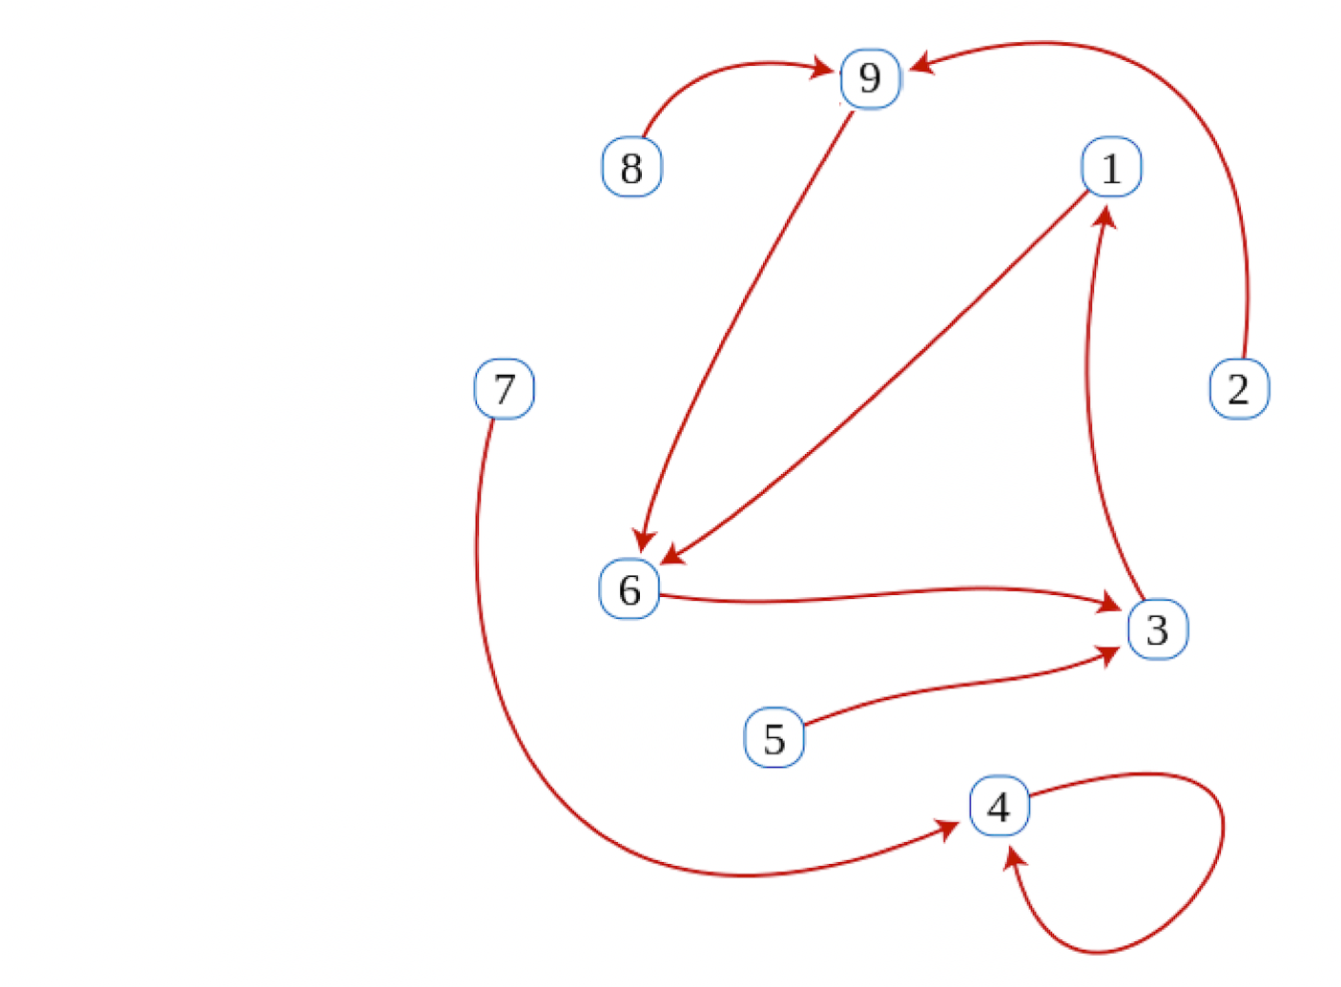
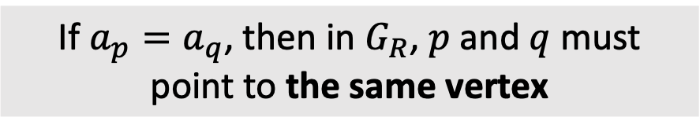
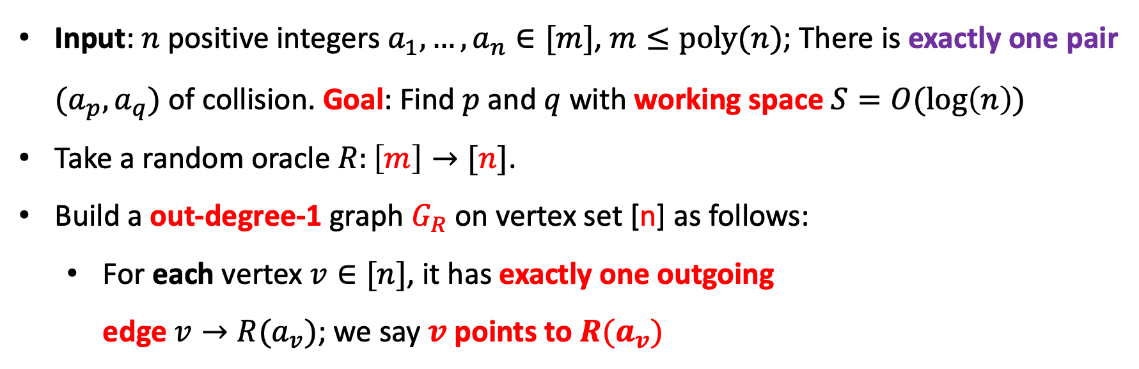
One round of BCM Algorithm: The (Implicit) Graph $G_{R}$
Input: $n$ positive integers $a_{1},…,a_{n}∈[m]$, $m≤poly(n)$; There is exactly one pair $(a_{p},a_{q})$ of collision. Goal: Find $p$ and $q$ with working space $S=O(log\left(n\right))$
Take a random oracle $R:\left[m\right]→[n]$.
Build a out-degree-1 graph $G_{R}$ on vertex set [n] as follows:
  For each vertex $v∈[n]$, it has exactly one outgoing
  edge $v→R(a_{v})$; we say $v$ points to $R(a_{v})$
If $a_{p}=a_{q}$, then in $G_{R}$, $p$ and $q$ must
point to the same vertex

Slide 16
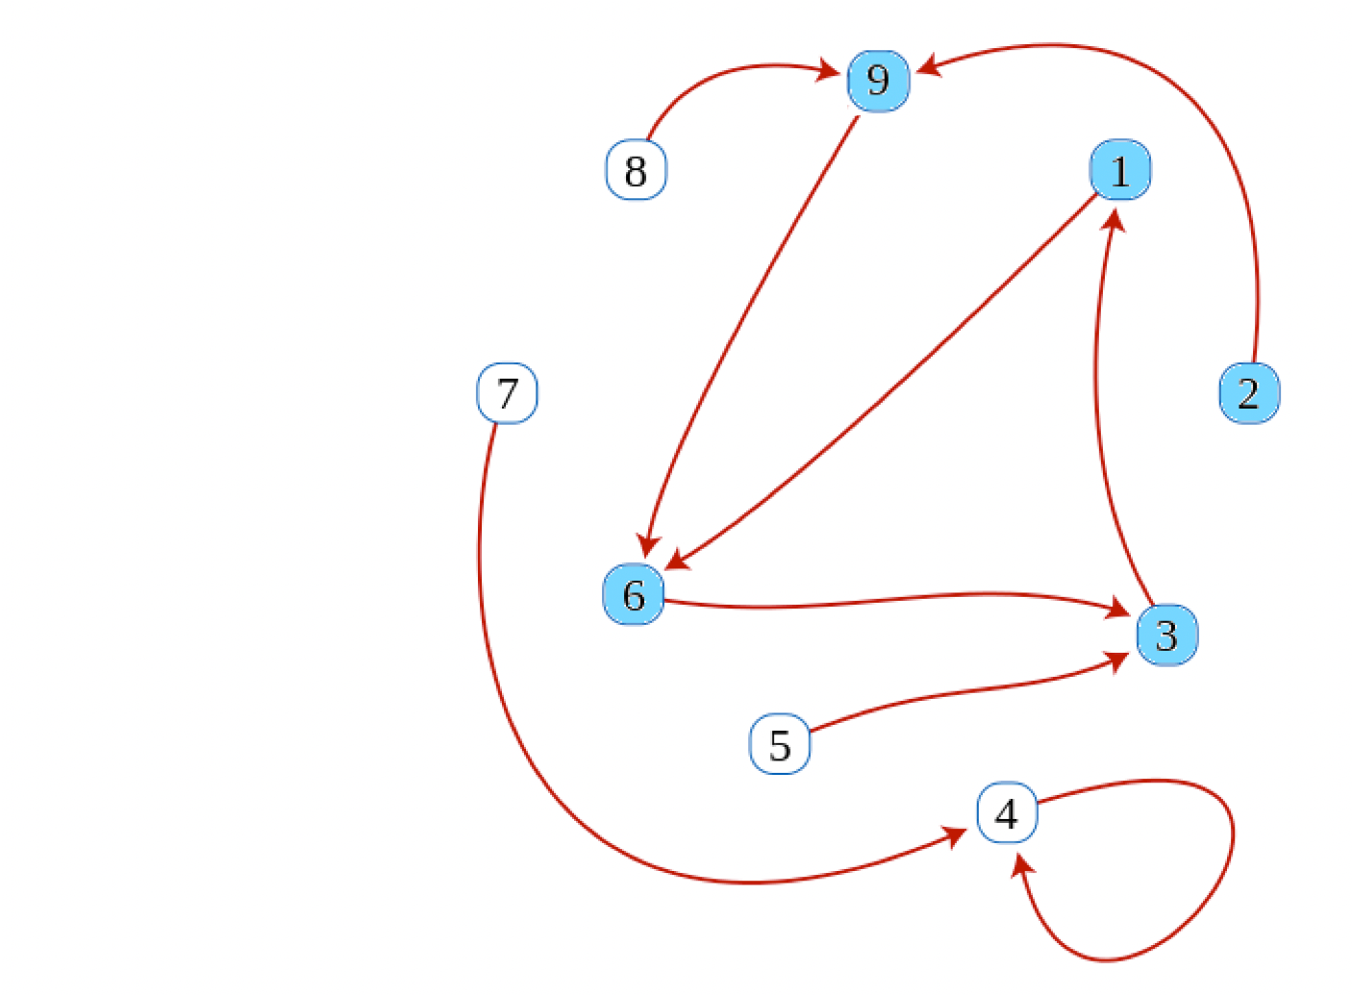

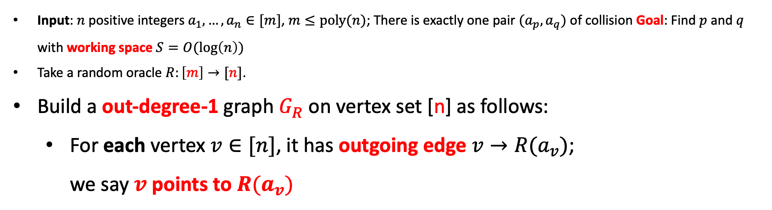
One round of BCM Algorithm: The $ρ$-shape
Input: $n$ positive integers $a_{1},…,a_{n}∈[m]$, $m≤poly(n)$; There is exactly one pair $(a_{p},a_{q})$ of collision Goal: Find $p$ and $q$ with working space $S=O(log\left(n\right))$
Take a random oracle $R:\left[m\right]→[n]$.
Build a out-degree-1 graph $G_{R}$ on vertex set [n] as follows:
  For each vertex $v∈[n]$, it has outgoing edge $v→R(a_{v})$;
  we say $v$ points to $R(a_{v})$
Key Observation
For any starting vertex $s∈[n]$, all vertices reachable from $s$ form a $ρ$-shape

Slide 17
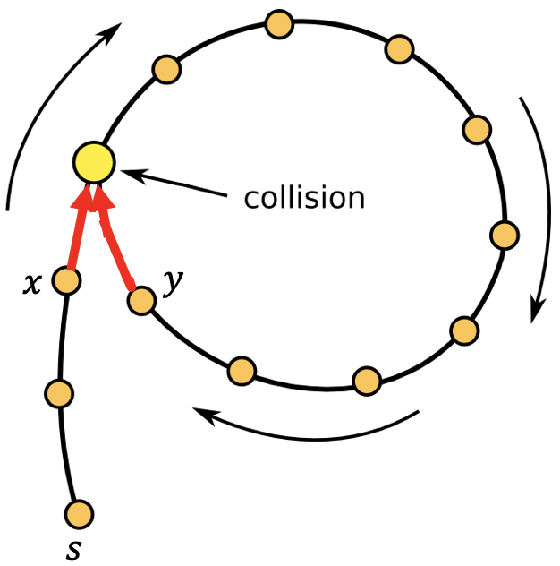
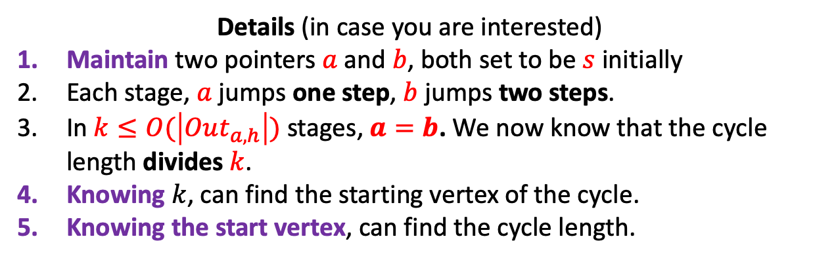
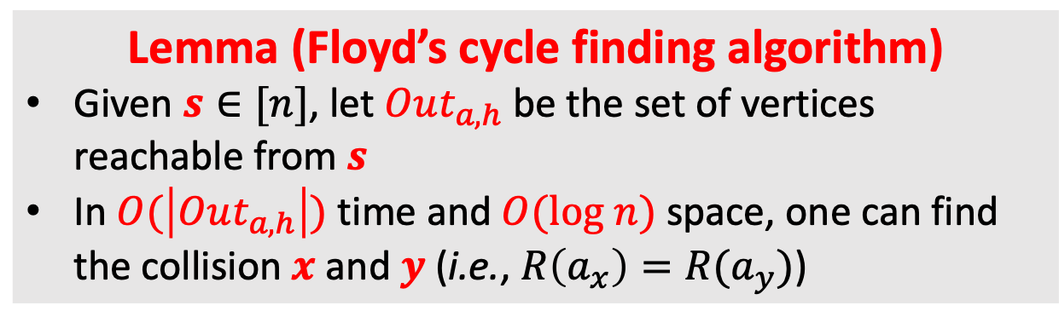
One round of BCM Algorithm: Floyd’s cycle finding
Build a out-degree-1 graph $G_{R}$ on vertex set [n] as follows:
  For each vertex $v∈[n]$, it has outgoing edge $v→R(a_{v})$; we say $v$ points to $R(a_{v})$
Lemma (Floyd’s cycle finding algorithm)
Given $s∈[n]$, let $Out_{a,h}$ be the set of vertices reachable from $s$
In $O(\left|Out_{a,h}\right|)$ time and $O(log n)$ space, one can find the collision $x$ and $y$ (i.e., $R\left(a_{x}\right)=R(a_{y})$)
Details (in case you are interested)
Maintain two pointers $a$ and $b$, both set to be $s$ initially
Each stage, $a$ jumps one step, $b$ jumps two steps.
In $k≤O(\left|Out_{a,h}\right|)$ stages, $a=b$. We now know that the cycle length divides $k$.
Knowing $k$, can find the starting vertex of the cycle.
Knowing the start vertex, can find the cycle length.

Slide 18
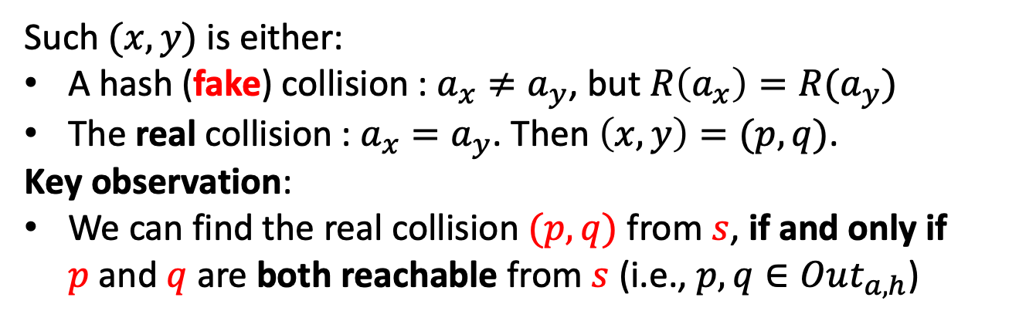
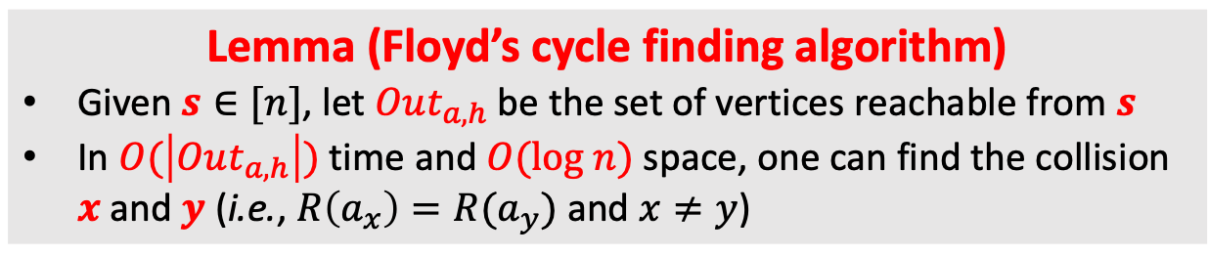
One round of BCM Algorithm: Detecting collision
Input: $n$ positive integers $a_{1},…,a_{n}∈[m]$, $m≤poly(n)$; There is exactly one pair $(a_{p},a_{q})$ of collision Goal: Find $p$ and $q$
Build a out-degree-1 graph $G_{R}$ on vertex set [n] as follows:
  For each vertex $v∈[n]$, it has outgoing edge $v→R(a_{v})$; we say $v$ points to $R(a_{v})$
Lemma (Floyd’s cycle finding algorithm)
Given $s∈[n]$, let $Out_{a,h}$ be the set of vertices reachable from $s$
In $O(\left|Out_{a,h}\right|)$ time and $O(log n)$ space, one can find the collision $x$ and $y$ (i.e., $R\left(a_{x}\right)=R(a_{y})$ and $x≠y$)
Such $(x,y)$ is either:
A hash (fake) collision : $a_{x}≠a_{y}$, but $R\left(a_{x}\right)=R(a_{y})$
The real collision : $a_{x}=a_{y}$. Then $\left(x,y\right)=(p,q)$.
Key observation:
We can find the real collision $(p,q)$ from $s$, if and only if
$p$ and $q$ are both reachable from $s$ (i.e., $p,q∈Out_{a,h}$)

Slide 19
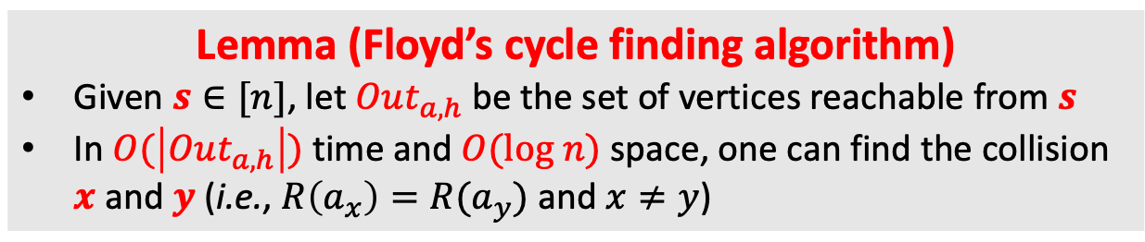
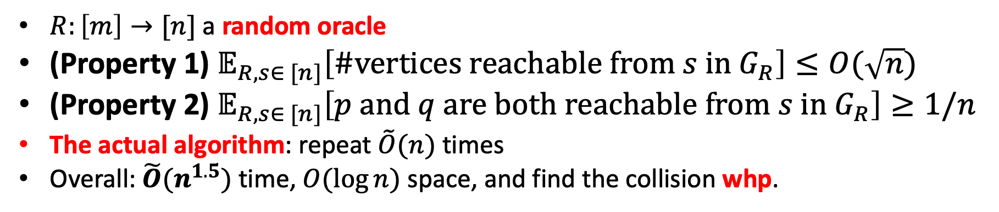
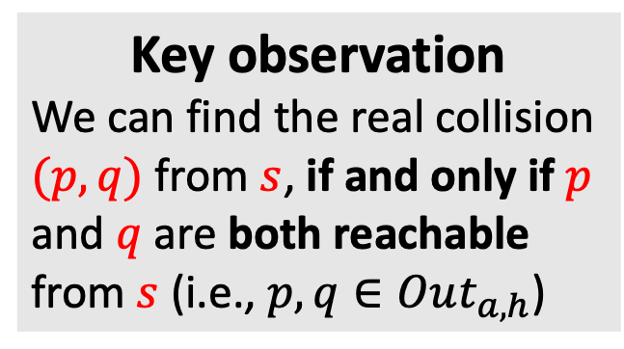
One round of BCM Algorithm: Birthday-Paradox-Type Properties
Input: $n$ positive integers $a_{1},…,a_{n}∈[m]$, $m≤poly(n)$; There is exactly one pair $(a_{p},a_{q})$ of collision Goal: Find $p$ and $q$
Lemma (Floyd’s cycle finding algorithm)
Given $s∈[n]$, let $Out_{a,h}$ be the set of vertices reachable from $s$
In $O(\left|Out_{a,h}\right|)$ time and $O(log n)$ space, one can find the collision $x$ and $y$ (i.e., $R\left(a_{x}\right)=R(a_{y})$ and $x≠y$)
Key observation
We can find the real collision $(p,q)$ from $s$, if and only if $p$ and $q$ are both reachable from $s$ (i.e., $p,q∈Out_{a,h}$)
$R:\left[m\right]→[n]$ a random oracle
(Property 1) $𝔼_{R,s∈ [n]}\left[\#vertices reachable from s in G_{R}\right]≤O(\sqrt{n})$
(Property 2) $𝔼_{R,s∈ [n]}\left[p and q are both reachable from s in G_{R}\right]≥1/n$
The actual algorithm: repeat $\tilde{O}(n)$ times
Overall: $\tilde{O}(n^{1.5})$ time, $O(\log{n})$ space, and find the collision whp.

Slide 20
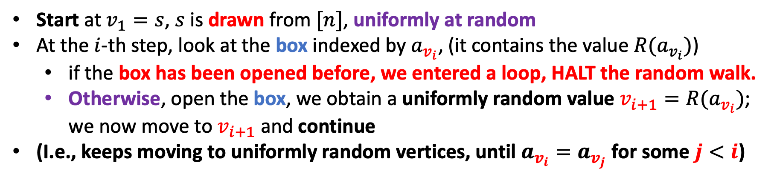
Birthday-Paradox-Type Properties: Analysis
Input: $n$ positive integers $a_{1},…,a_{n}∈[m]$, $m≤poly(n)$; There is exactly one pair $(a_{p},a_{q})$ of collision Goal: Find $p$ and $q$
Build a out-degree-1 graph $G_{R}$ on vertex set [n] as follows:
  For each vertex $v∈[n]$, it has outgoing edge $v→R(a_{v})$; we say $v$ points to $R(a_{v})$
Think of the random oracle $R:\left[m\right]→[n]$ as $m$ boxes, each stores a random value from $[m]$
Start at $v_{1}=s$, $s$ is drawn from $[n]$, uniformly at random
At the $i$-th step, look at the box indexed by $a_{v_{i}}$, (it contains the value $R(a_{v_{i}})$)
  if the box has been opened before, we entered a loop, HALT the random walk.
  Otherwise, open the box, we obtain a uniformly random value $v_{i+1}=R(a_{v_{i}})$; we now move to $v_{i+1}$ and continue
(I.e., keeps moving to uniformly random vertices, until $a_{v_{i}}=a_{v_{j}}$ for some $j<i$)

Slide 21
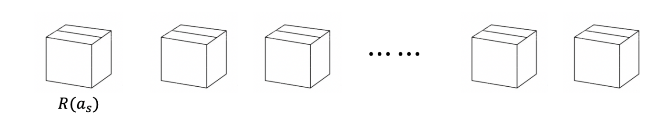
Birthday-Paradox-Type Properties: Analysis
Input: $n$ positive integers $a_{1},…,a_{n}∈[m]$, $m≤poly(n)$; There is exactly one pair $(a_{p},a_{q})$ of collision Goal: Find $p$ and $q$
Think of the random oracle $R:\left[m\right]→[n]$ as $m$ boxes, each stores a random value from $[m]$

Slide 22
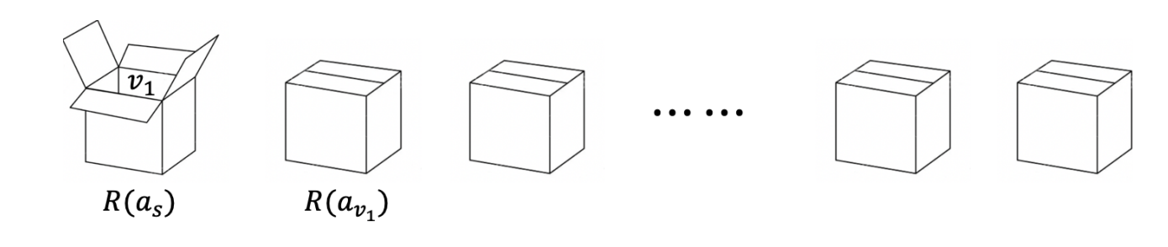
Birthday-Paradox-Type Properties: Analysis
Input: $n$ positive integers $a_{1},…,a_{n}∈[m]$, $m≤poly(n)$; There is exactly one pair $(a_{p},a_{q})$ of collision Goal: Find $p$ and $q$
Think of the random oracle $R:\left[m\right]→[n]$ as $m$ boxes, each stores a random value from $[m]$

Slide 23
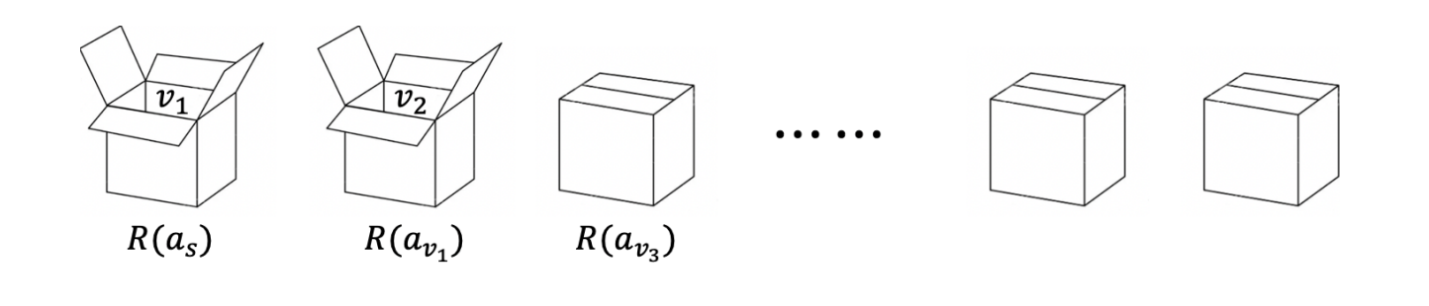
Birthday-Paradox-Type Properties: Analysis
Input: $n$ positive integers $a_{1},…,a_{n}∈[m]$, $m≤poly(n)$; There is exactly one pair $(a_{p},a_{q})$ of collision Goal: Find $p$ and $q$
Think of the random oracle $R:\left[m\right]→[n]$ as $m$ boxes, each stores a random value from $[m]$

Slide 24
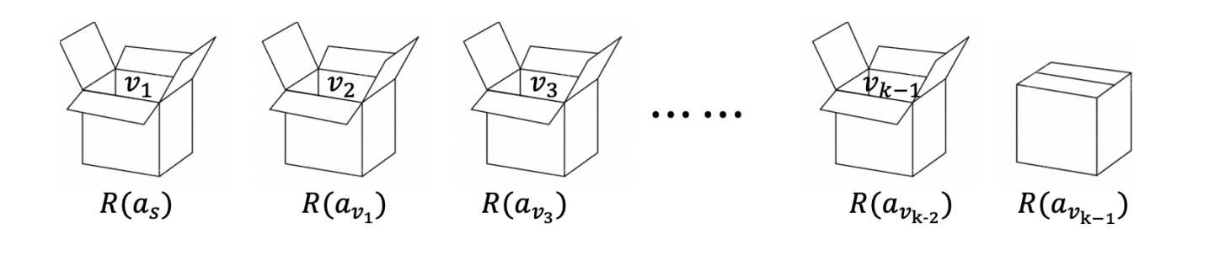
Birthday-Paradox-Type Properties: Analysis
Input: $n$ positive integers $a_{1},…,a_{n}∈[m]$, $m≤poly(n)$; There is exactly one pair $(a_{p},a_{q})$ of collision Goal: Find $p$ and $q$
Think of the random oracle $R:\left[m\right]→[n]$ as $m$ boxes, each stores a random value from $[m]$

Slide 25
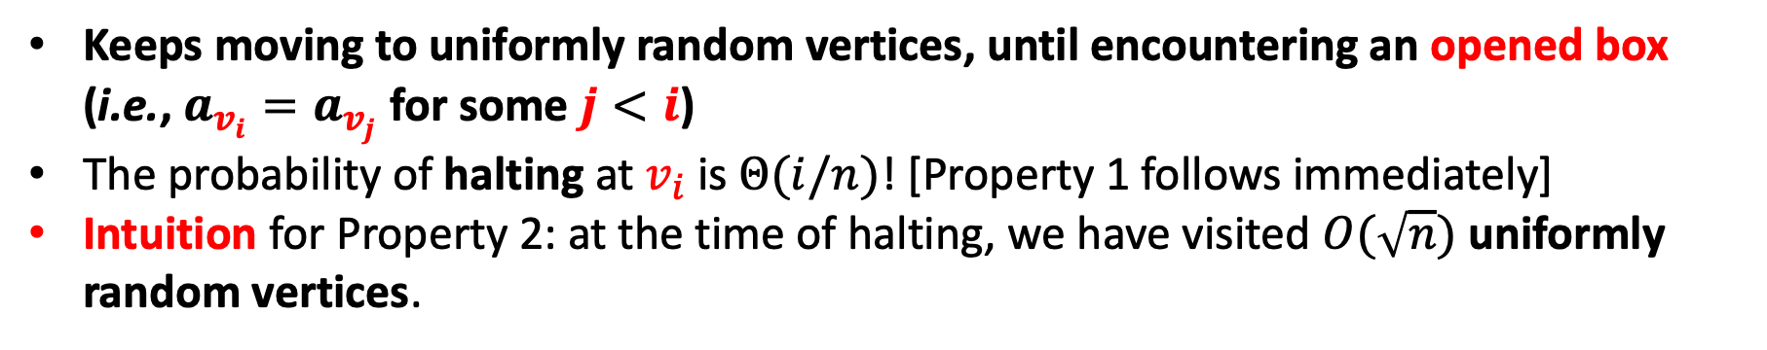
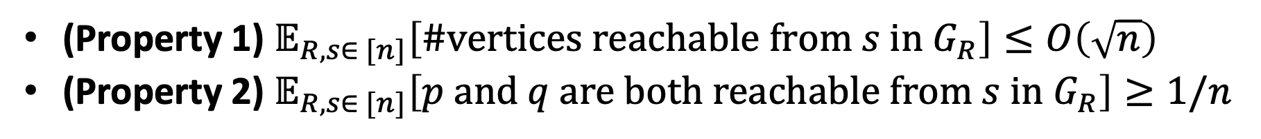
Birthday-Paradox-Type Properties: Analysis
Input: $n$ positive integers $a_{1},…,a_{n}∈[m]$, $m≤poly(n)$; There is exactly one pair $(a_{p},a_{q})$ of collision Goal: Find $p$ and $q$
Build a out-degree-1 graph $G_{R}$ on vertex set [n] as follows:
  For each vertex $v∈[n]$, it has outgoing edge $v→R(a_{v})$; we say $v$ points to $R(a_{v})$
(Property 1) $𝔼_{R,s∈ [n]}\left[\#vertices reachable from s in G_{R}\right]≤O\left(\sqrt{n}\right)$
(Property 2) $𝔼_{R,s∈ [n]}\left[p and q are both reachable from s in G_{R}\right]≥1/n$
Think of the random oracle $R:\left[m\right]→[n]$ as $m$ boxes, each stores a random value from $[m]$
Keeps moving to uniformly random vertices, until encountering an opened box (i.e., $a_{v_{i}}=a_{v_{j}}$ for some $j<i$)
The probability of halting at $v_{i}$ is $Θ(i/n)$! [Property 1 follows immediately]
Intuition for Property 2: at the time of halting, we have visited $O(\sqrt{n})$ uniformly random vertices.

Slide 26
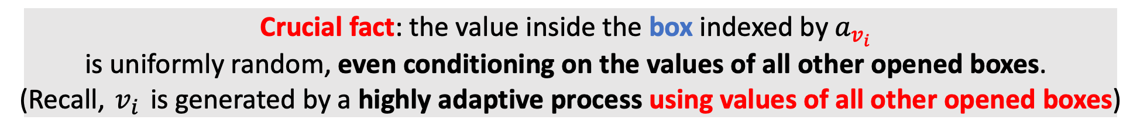
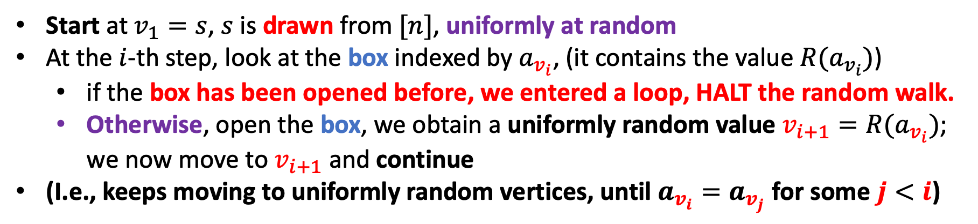
Why we need random oracle?
Start at $v_{1}=s$, $s$ is drawn from $[n]$, uniformly at random
At the $i$-th step, look at the box indexed by $a_{v_{i}}$, (it contains the value $R(a_{v_{i}})$)
  if the box has been opened before, we entered a loop, HALT the random walk.
  Otherwise, open the box, we obtain a uniformly random value $v_{i+1}=R(a_{v_{i}})$; we now move to $v_{i+1}$ and continue
(I.e., keeps moving to uniformly random vertices, until $a_{v_{i}}=a_{v_{j}}$ for some $j<i$)
Crucial fact: the value inside the box indexed by $a_{v_{i}}$
is uniformly random, even conditioning on the values of all other opened boxes.
(Recall, $v_{i}$ is generated by a highly adaptive process using values of all other opened boxes)
This is true only if $R$ is at least $\sqrt{n}$-wise independent. (too much space)

Slide 27
Today’s Plan
Part I (Background and Our Results)
Part II (Proof Overview)
  Recap of the BCM algorithm
  Construction of the pseudorandom hash family
  A Communication Perspective of the pseudorandom walk
  An idealized analysis

Slide 28
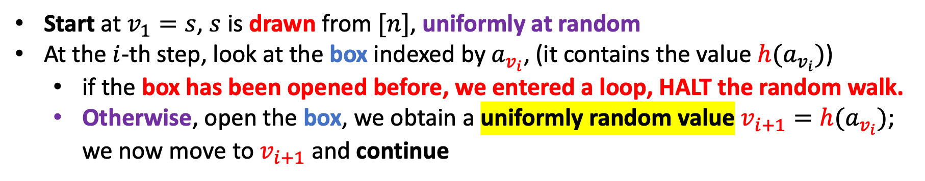


Can we make the random walk less adaptive?
Say, we take an $O(log n)$-wise independent $h:\left[m\right]→[n]$
Start at $v_{1}=s$, $s$ is drawn from $[n]$, uniformly at random
At the $i$-th step, look at the box indexed by $a_{v_{i}}$, (it contains the value $h(a_{v_{i}})$)
  if the box has been opened before, we entered a loop, HALT the random walk.
  Otherwise, open the box, we obtain a uniformly random value $v_{i+1}=h(a_{v_{i}})$; we now move to $v_{i+1}$ and continue
This only works for $O(log n)$ steps…
Key Issue:
$v_{i}$ depends on the values in ALL the opened boxes!!
Our key idea: reduce the dependence by using more than one $O(\log{n})$-wise independent hash func.

Slide 29
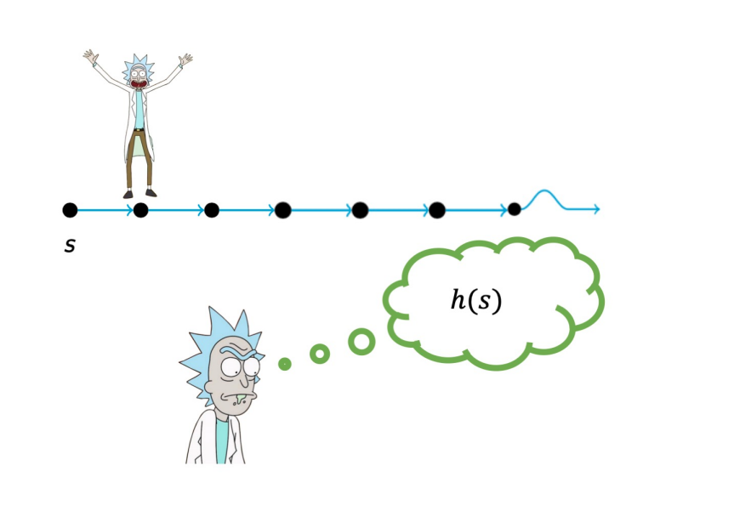
Intuition: Memory Eraser
Say, we take an $O(log n)$-wise independent $h:\left[m\right]→[n]$

Slide 30
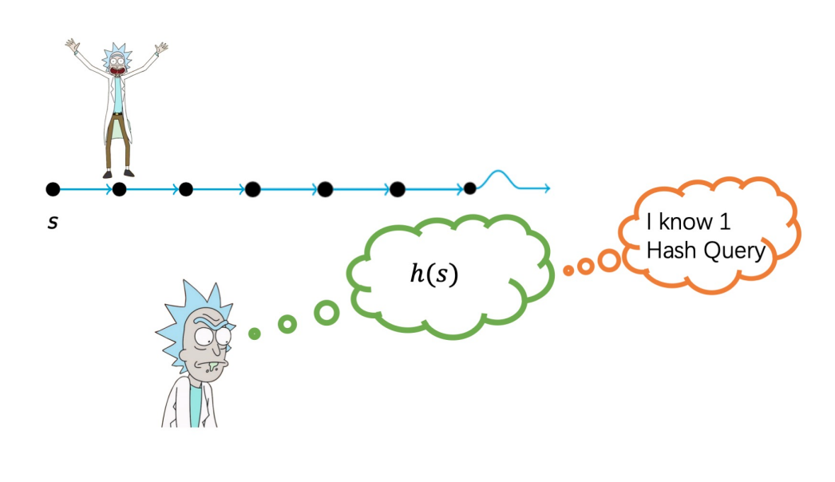
Intuition: Memory Eraser
Say, we take an $O(log n)$-wise independent $h:\left[m\right]→[n]$

Slide 31
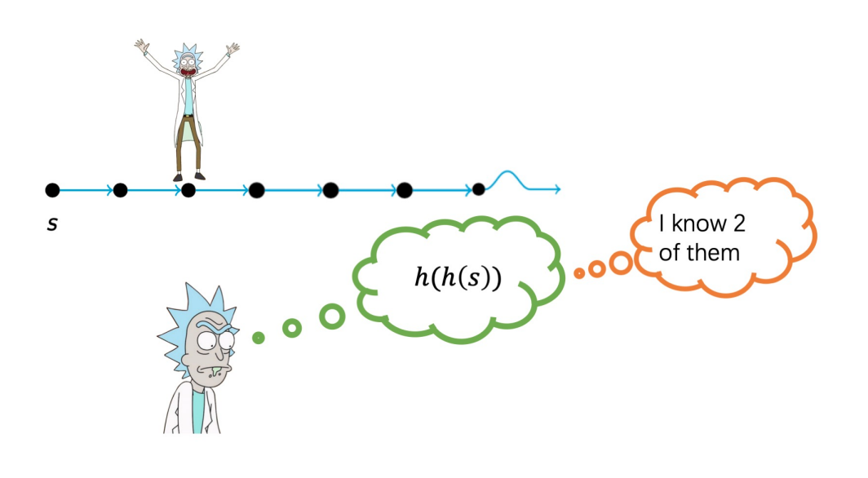
Intuition: Memory Eraser
Say, we take an $O(log n)$-wise independent $h:\left[m\right]→[n]$

Slide 32
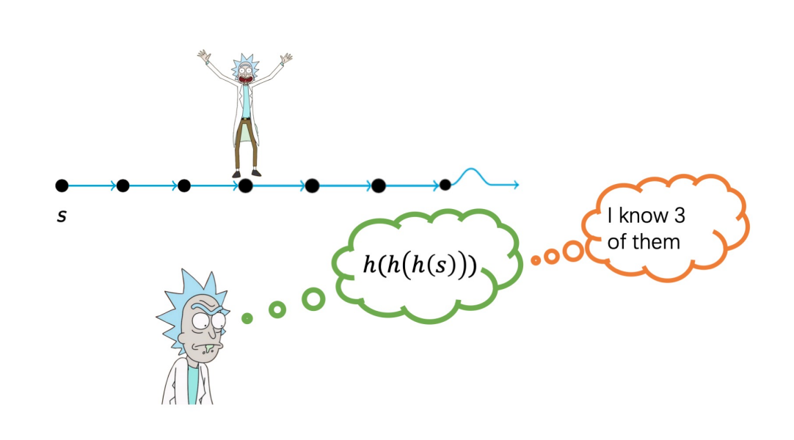
Intuition: Memory Eraser
Say, we take an $O(log n)$-wise independent $h:\left[m\right]→[n]$

Slide 33
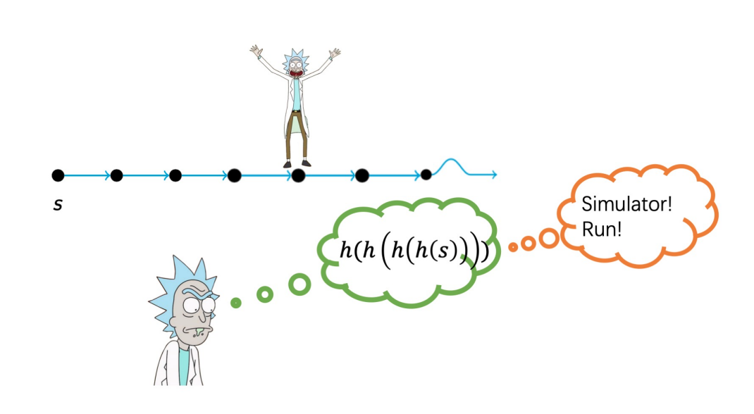

Intuition: Memory Eraser
Say, we take an $O(log n)$-wise independent $h:\left[m\right]→[n]$
Problem: He knows too much about $h$!

Slide 34
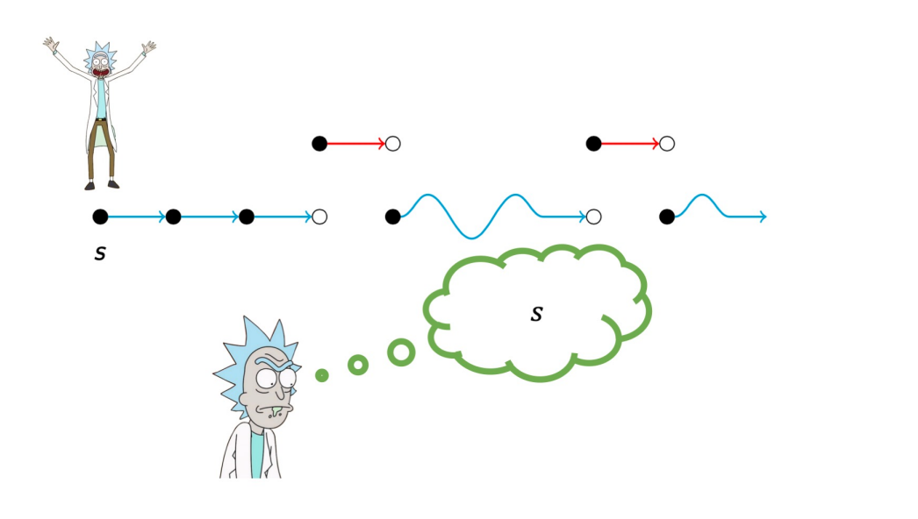
Intuition: Memory Eraser
Say, we take an $O(log n)$-wise independent $h:\left[m\right]→[n]$
Switch to a second hash function every $O(\log{n})$ steps

Slide 35
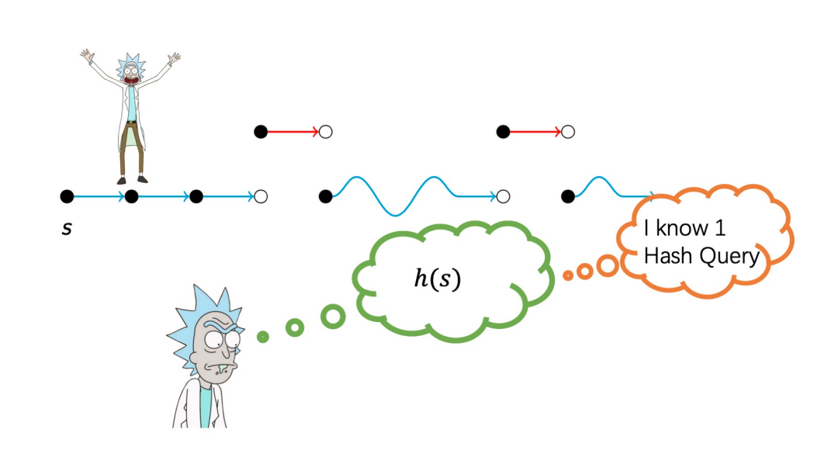
Intuition: Memory Eraser
Say, we take an $O(log n)$-wise independent $h:\left[m\right]→[n]$
Switch to a second hash function every $O(\log{n})$ steps

Slide 36
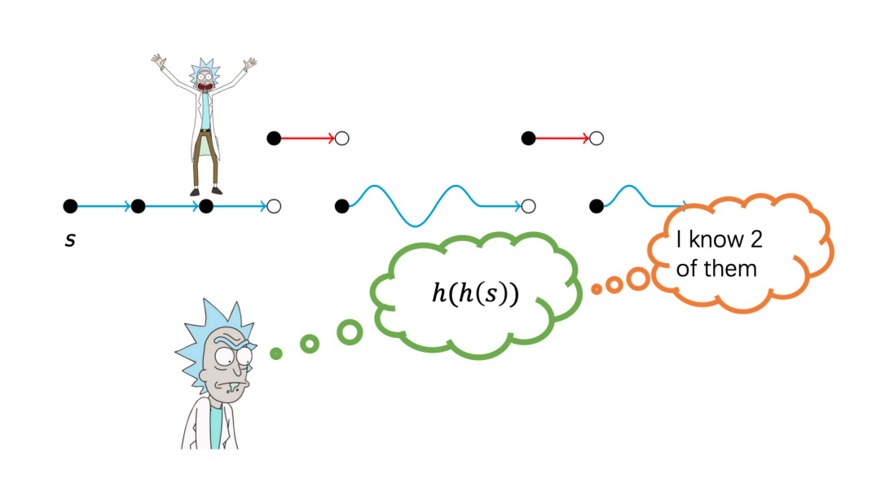
Intuition: Memory Eraser
Say, we take an $O(log n)$-wise independent $h:\left[m\right]→[n]$
Switch to a second hash function every $O(\log{n})$ steps

Slide 37

Intuition: Memory Eraser
Say, we take an $O(log n)$-wise independent $h:\left[m\right]→[n]$
Switch to a second hash function every $O(\log{n})$ steps

Slide 38


Intuition: Memory Eraser
Say, we take an $O(log n)$-wise independent $h:\left[m\right]→[n]$
Solution: Erase his memory (indeed the dependency) about $h$ via one step of another hash function
Switch to a second hash function every $O(\log{n})$ steps

Slide 39


Construction of Pseudorandom Hash Function
Let $t=\frac{1}{2}\log{n}$ and $κ=C\log{n}$.
Sample $h_{1},h_{2},…,h_{t}$, each $h_{i}:\left[m\right]→\left[n\right]∪\{⊥\}$ satisfies:
  For every $j∈[m]$ and $v∈[n]$,
    Pr$\left[h_{i}\left(j\right)=⊥\right]=1/2$
    Pr$\left[h_{i}\left(j\right)=v\right]=1/2n$.
  $h_{i}$ is $κ$-wise independent
Now, define $h$ as follows: for each $j∈[m]$, find the smallest $p≤t$ s.t. $h_{p}\left(j\right)≠0$, set $h\left(j\right)=h_{p}(j)$. If no such $p$, set $h\left(j\right)=1$.
Again, imagine we have $m$ boxes, $j$-th box contains $h(j)$. More specifically, we label box $j$ by $h_{p}$ for the smallest $p≤t$ s.t. $h_{p}\left(j\right)≠0$.
We simulate a random walk starting from $s$ and open the boxes as usual. Whenever we open a $h_{p}$ box, intuitively speaking, we kill the dependence on all the currently opened $h_{p−1}$ boxes, thereby we can close them!
However, there is a SUBTLE issue!

Slide 40


Main Theorem from Key Properties
Input: $n$ positive integers $a_{1},…,a_{n}∈[m]$, $m≤poly(n)$; There is exactly one pair $(a_{p},a_{q})$ of collision Goal: Find $p$ and $q$
Let $t=\frac{1}{2}\log{n}$ and $κ=C\log{n}$.
Sample $h_{1},h_{2},…,h_{t}$, each $h_{i}:\left[m\right]→\left[n\right]∪\{⊥\}$ satisfies:
  For every $j∈[m]$ and $v∈[n]$,
    Pr$\left[h_{i}\left(j\right)=⊥\right]=1/2$
    Pr$\left[h_{i}\left(j\right)=v\right]=1/2n$.
  $h_{i}$ is $κ$-wise independent
Now, define $h$ as follows: for each $j∈[m]$, find the smallest $p≤t$ s.t. $h_{p}\left(j\right)≠0$, set $h\left(j\right)=h_{p}(j)$. If no such $p$, set $h\left(j\right)=1$.
(Property 1) $𝔼_{h,s∈ [n]}\left[\#vertices reachable from s in G_{h}\right]≤O(\sqrt{n})$
(Property 2) $𝔼_{h,s∈ [n]}\left[p and q are both reachable from s in G_{h}\right]≥Ω(1/n)$
Repeat $\tilde{O}(n)$ times; Overall: $\tilde{O}(n^{1.5})$ time, $O(\log{n})$ space, and finds the collision whp.

Slide 41
Today’s Plan
Part I (Background and Our Results)
Part II (Proof Overview)
  Recap of the BCM algorithm
  Construction of the pseudorandom hash family
  A Communication Perspective of the pseudorandom walk
  An idealized analysis

Slide 42

The pseudorandom walk and the HALTING condition
Input: $n$ positive integers $a_{1},…,a_{n}∈[m]$, $m≤poly(n)$; There is exactly one pair $(a_{p},a_{q})$ of collision Goal: Find $p$ and $q$
Start at $v_{1}=s$, $s$ is drawn from $[n]$, uniformly at random
At the $i$-th step, look at the box indexed by $a_{v_{i}}$, (it contains the value $h(a_{v_{i}})$)
  if the box has been opened before, we entered a loop, HALT the walk.
  Otherwise, open the box, we obtain a value $v_{i+1}=h(a_{v_{i}})$; we now move to $v_{i+1}$ and continue
Key issue
The halting condition is complicated and depends on all previous opened boxes
To have a better understanding of the pseudorandom walk, Lyu and Zhu introduced
a communication perspective of the pseudorandom walk

Slide 43



A Communication Perspective of the pseudorandom walk
t agents, the $i$-th agent holds $h_{i}$; For simplicity, we use $h_{i}$ to denote the $i$-th agent.
A top-down perspective: Imagine you hold $h_{t}$ and want to simulate a random walk starting from $s$; you would first ask $h_{≤t−1}$ to run from $s$ until they reach a vertex $v$ s.t. $h_{≤t−1}\left(v\right)≡0$, then you use$h_{t}(v)$ to decide the next step.
$h_{t}$ gets a random starting vertex $s$;
When an agent $h_{d}$ gets a vertex $v∈[n]$, it first sends $v$ to $h_{d−1}$, and asks $h_{d−1}$ (together with $h_{≤d−2}$) to generate a sequence starting $x$. After $h_{d−1}$
returns a vertex $x′$ such that $h_{≤d−1}\left(x^{′}\right)≡0$. $h_{d}$ queries $h_{d}(x′)$:
  If $h_{d}\left(x^{′}\right)≠0$, it passes $x^{′′}=h_{d}(x′)$ to $h_{d−1}$; continue the walk
  Otherwise, $h_{d}\left(x^{′}\right)=0$, it returns $x′$ to $h_{d+1}$.
$$h_{≤t−1}(v):(h_{1}(v),h_{2}(v),…,h_{t−1}(v))$$

Slide 44

















Why Top-Down perspective?
It makes the tree structure of the pseudorandom walk very clear
$$s$$
IF $h_{t}\left(a_{u_{1}}\right)≠0$
IF $h_{t}\left(a_{u_{2}}\right)≠0$
$$h_{t}$$
$$u_{1}→{v_{1}=h}_{t}(a_{u_{1}})$$
$$u_{2}→{v_{2}=h}_{t}(a_{u_{2}})$$
$$s$$
$$u_{1}$$
$$v_{1}$$
$$u_{2}$$
$$v_{2}$$
$$h_{≤t−1}$$
$$walk_{0}$$
$$h_{≤t−1}\left(a_{u_{1}}\right)≡0$$
$$h_{≤t−1}\left(a_{u_{2}}\right)≡0$$
$$walk_{1}$$
If $h_{t}$ is called $m$ times, the whole walk is divided into $m+1$ segments.
$h_{t−1}$ divides each of them into some segments, and so on.
Key observation: whp, at any stage, #segments $≤O(\log{n})$ (each IF happens w.p. $1/2$)

Slide 45















Why Top-Down perspective?
It makes the tree structure of the pseudorandom walk very clear
$$walk$$
$$h_{t}$$
$${walk}_{0}$$
$${walk}_{1}$$
$${walk}_{2}$$
$$h_{t−1}$$
$$u_{1}→{v_{1}=h}_{t}(a_{u_{1}})$$
$$h_{t−1}$$
$$h_{t−1}$$
$$u_{2}→{v_{2}=h}_{t}(a_{u_{2}})$$
$$h_{t−2}$$
$$u_{2,1}→{v_{2,1}=h}_{t}(a_{u_{2,1}})$$
$$h_{t−2}$$
$$u_{2,2}→{v_{2,2}=h}_{t}(a_{u_{2,2}})$$
$$h_{t−2}$$
Key observation: whp, for every node, #children $≤O(\log{n})$; expected #children = 2

Slide 46
Idealized Analysis for Property (2)
$t=\frac{1}{2}\log{n}$ agents, the $i$-th agent holds $h_{i}$; For simplicity, we use $h_{i}$ to denote the $i$-th agent.
Simplifying Assumption
For every agent $h_{i}$, whenever $h_{i}$ queries $h_{i}(a_{v})$, $h_{i}(a_{v})$ has not been queried before.
Claim
Under this assumption, any two distinct values in the tree are uniformly random

Slide 47





To ``observe’’ a hash value
To ``observe’’ a box (hash value) in the red subtree, we only need to ``observe’’ the red part outside the tree
$$h_{t}$$
$$h_{t−1}$$
$$u_{1}→{v_{1}=h}_{t}(a_{u_{1}})$$
$$h_{t−1}$$
$$h_{t−1}$$
$$u_{2}→{v_{2}=h}_{t}(a_{u_{2}})$$
$$h_{t−2}$$
$$h_{t−2}$$
$$h_{t−2}$$
$$u_{2,1}→{v_{2,1}=h}_{t−1}(a_{u_{2,1}})$$
$$u_{2,2}→{v_{2,2}=h}_{t−1}(a_{u_{2,2}})$$

Slide 48


To ``observe’’ a hash value
To ``observe’’ a box (hash value) in the red subtree, we only need to ``observe’’ the red part outside the tree
$$h_{t}$$
$$h_{t−1}$$
$$u_{1}→{v_{1}=h}_{t}(a_{u_{1}})$$
$$h_{t−1}$$
$$h_{t−1}$$
$$u_{2}→{v_{2}=h}_{t}(a_{u_{2}})$$
$$h_{t−2}$$
$$u_{2,1}→{v_{2,1}=h}_{t−1}(a_{u_{2,1}})$$
$$h_{t−2}$$
$$u_{2,2}→{v_{2,2}=h}_{t−1}(a_{u_{2,2}})$$
$$h_{t−2}$$

Slide 49


Idealized Analysis for Property (2)
t agents, the $i$-th agent holds $h_{i}$; For simplicity, we use $h_{i}$ to denote the $i$-th agent.
Simplifying Assumption
For every agent $h_{i}$, whenever $h_{i}$ queries $h_{i}(a_{v})$, $h_{i}(a_{v})$ has not been queried before
Claim
Under this assumption, any two distinct values in the tree are uniformly random
To observe two hash values in the tree, one only needs to query each $h_{i}$ $O(\log{n})$ times
By simplifying assumptions, all these queries are distinct.
The claim follows from the fact that all $h_{i}$ are $O(\log{n})$-wise independent
The whole tree has size roughly $2^{t}≈\sqrt{n}$.
Contains $p,q$ with probability roughly ${(2}^{t}/n)⋅(2^{t}/n)≈1/n$.
(Property 2) $𝔼_{h,s∈ [n]}\left[p and q are both reachable from s in G_{h}\right]≥Ω(1/n)$

Slide 50
Subtracting the bad event
$t$ agents, the $i$-th agent holds $h_{i}$; For simplicity, we use $h_{i}$ to denote the $i$-th agent.
Simplifying Assumption
For every agent $h_{i}$, whenever $h_{i}$ queries $h_{i}(a_{v})$, $h_{i}(a_{v})$ has not been queried before
We need to subtract the bad event that, there exist $u,v$ before $max(p,q)$ s.t. $a_{u}=a_{v}$
Intuitively speaking, now we want to ``observe’’ 4 values in the tree
We use a coupling argument to upper bound the probability of the bad event
I am hiding a lot of details, check Lyu and Zhu‘s paper for the precise argument!

