Slide 1
Strong Average-Case Circuit Lower Bounds from Non-trivial Derandomization
Lijie Chen
MIT
Hanlin Ren
IIIS, Tsinghua

Slide 2
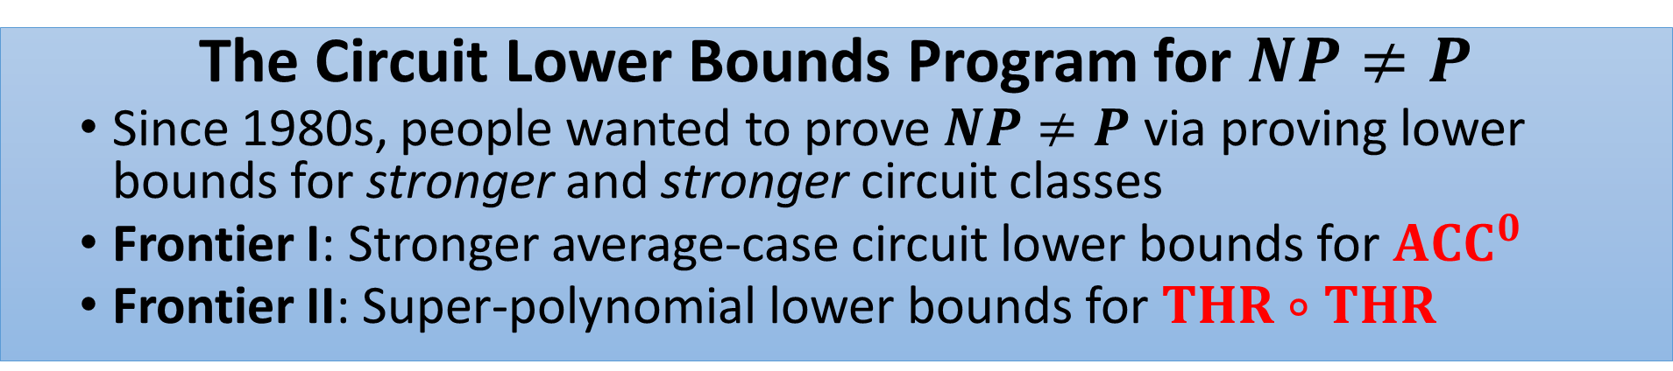
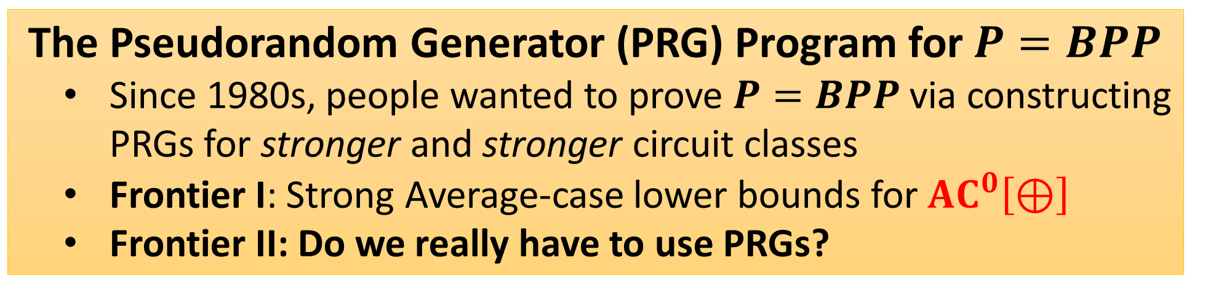
(Oversimplified) History and Motivation
The Circuit Lower Bounds Program for $NP≠P$
  Since 1980s, people wanted to prove $NP≠P$ via proving lower bounds for stronger and stronger circuit classes
  Frontier I: Stronger average-case circuit lower bounds for $ACC^{0}$
  Frontier II: Super-polynomial lower bounds for $THR∘THR$
The Pseudorandom Generator (PRG) Program for $P=BPP$
  Since 1980s, people wanted to prove $P=BPP$ via constructing PRGs for stronger and stronger circuit classes
  Frontier I: Strong Average-case lower bounds for $AC^{0}\left[⊕\right]$
  Frontier II: Do we really have to use PRGs?
Is Black-box derand. equivalent to White-box derand.?
Notes:
TODO:dots

Slide 3
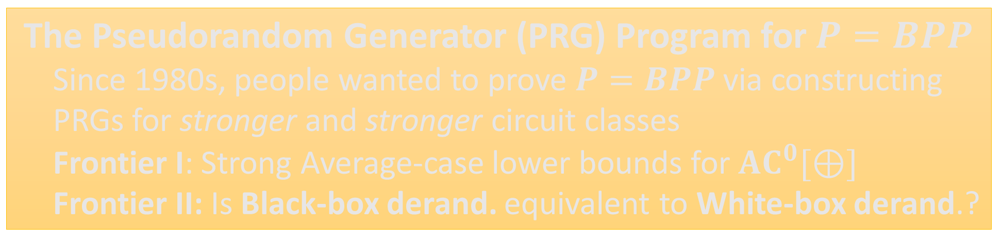
(Oversimplified) History and Motivation
The Circuit Lower Bounds Program for $NP≠P$
  Since 1980s, people wanted to prove $NP≠P$ via proving lower bounds for stronger and stronger circuit classes
  Frontier I: Stronger average-case circuit lower bounds for $ACC^{0}$
  Frontier II: Super-polynomial lower bounds for $THR∘THR$
The Pseudorandom Generator (PRG) Program for $P=BPP$
  Since 1980s, people wanted to prove $P=BPP$ via constructing PRGs for stronger and stronger circuit classes
  Frontier I: Strong Average-case lower bounds for $AC^{0}[⊕]$
  Frontier II: Is Black-box derand. equivalent to White-box derand.?
Notes:
TODO:dots

Slide 4

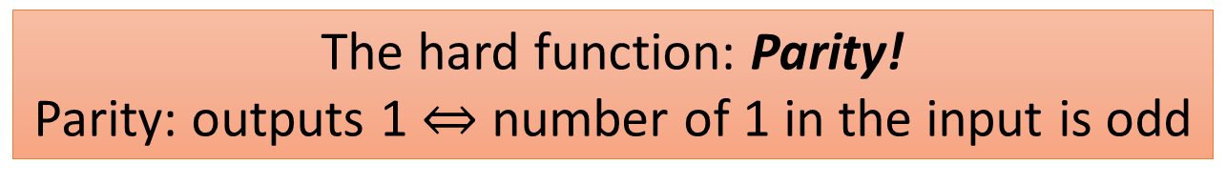
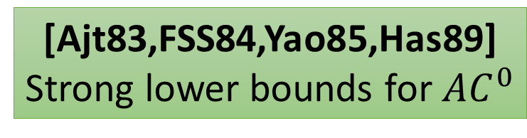
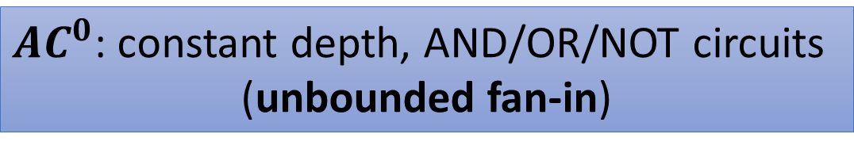
(Oversimplified) History: Part 1
The Circuit Lower Bounds Program for $NP≠P$
People wanted circuit lower bounds (and $P≠NP$), but now we know it is HARD…
But it seemed not that hard in 1980s
Quest at that time: understand the constant depth circuits first!
$AC^{0}$: constant depth, AND/OR/NOT circuits
(unbounded fan-in)
[Ajt83,FSS84,Yao85,Has89]
Strong lower bounds for $AC^{0}$
The hard function: Parity!
Parity: outputs 1 $⇔$ number of 1 in the input is odd

Slide 5
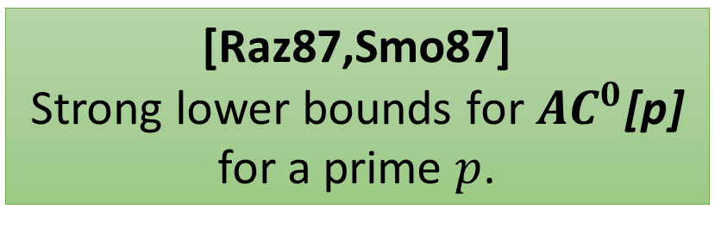
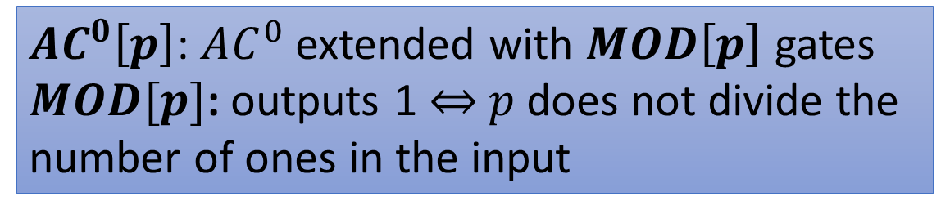
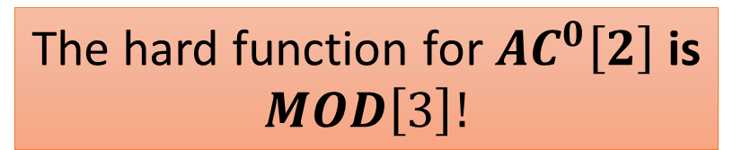
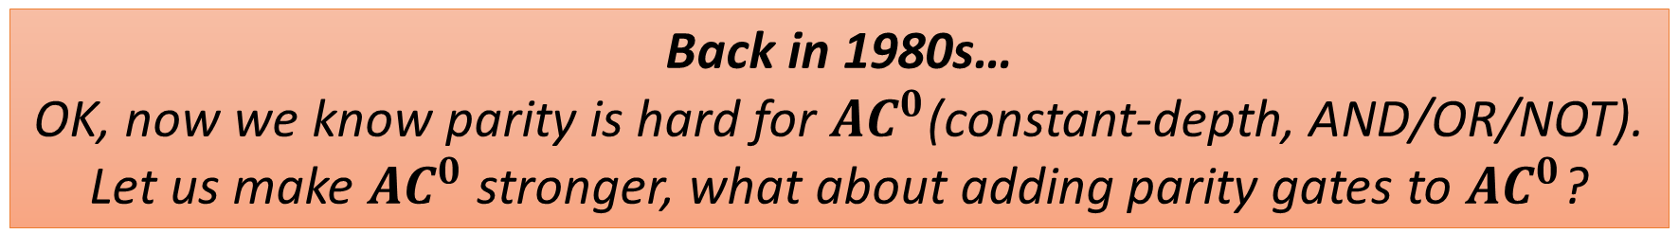
The Circuit Lower Bounds Program for $NP≠P$
(Oversimplified) History: Part 2
Back in 1980s…
OK, now we know parity is hard for $AC^{0}$(constant-depth, AND/OR/NOT).
Let us make $AC^{0}$ stronger, what about adding parity gates to $AC^{0}$?
Philosophy: strengthen the circuit class ``just a little bit’’ by adding the most
simple function it cannot compute as available gates.
Hopefully, we can get to general circuits very soon!
$AC^{0}\left[p\right]$: $AC^{0}$ extended with $MOD\left[p\right]$ gates
$MOD[p]$: outputs 1 $⇔$ $p$ does not divide the
number of ones in the input
[Raz87,Smo87]
Strong lower bounds for $AC^{0}$[p]
for a prime $p$.
The hard function for $AC^{0}\left[2\right]$ is
$$MOD\left[3\right]!$$

Slide 6

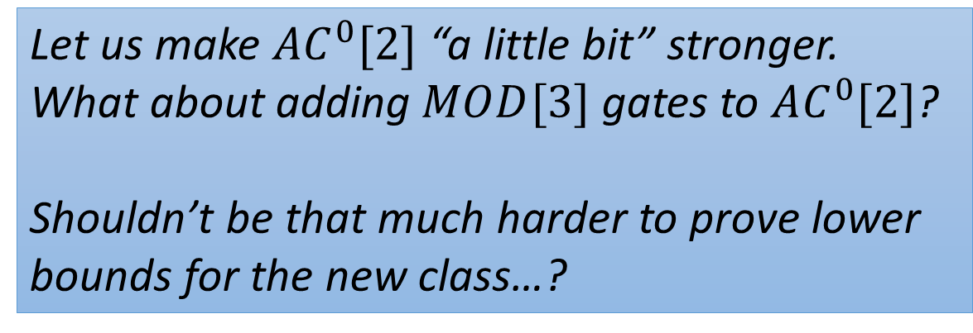
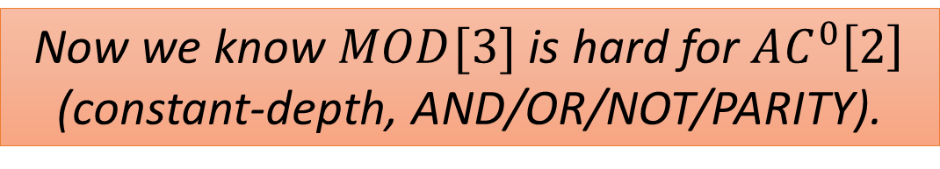



The Circuit Lower Bounds Program for $NP≠P$
(Oversimplified) History: Part 3
Back in 1980s…
Nice, so far everything has been very successful!
Now we know $MOD[3]$ is hard for $AC^{0}\left[2\right]$
(constant-depth, AND/OR/NOT/PARITY).
$$AC^{0}$$
add parity
$$AC^{0}[2]$$
Let us make $AC^{0}[2]$ “a little bit” stronger. What about adding $MOD[3]$ gates to $AC^{0}[2]$?
Shouldn’t be that much harder to prove lower bounds for the new class…?
add $MOD[3]$
$$AC^{0}[6]$$
Umm…

Slide 7

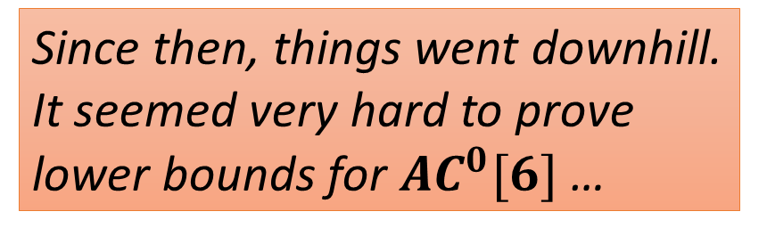
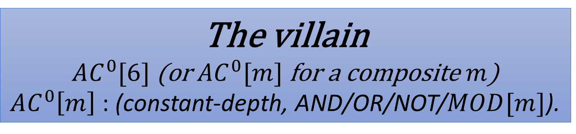
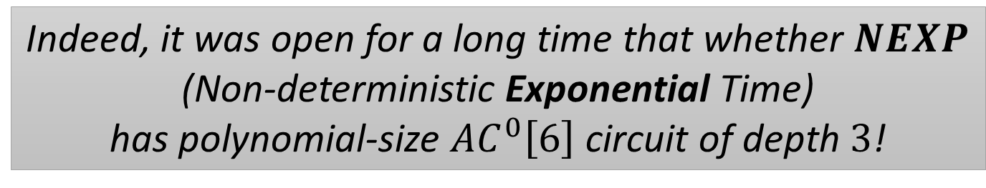
The Circuit Lower Bounds Program for $NP≠P$
(Oversimplified) History: Part 4
The villain
$AC^{0}[6]$ (or $AC^{0}[m]$ for a composite $m$)
$AC^{0}\left[m\right]$ : (constant-depth, AND/OR/NOT/$MOD[m]$).
Since then, things went downhill.
It seemed very hard to prove
lower bounds for $AC^{0}[6]$ …
Indeed, it was open for a long time that whether $NEXP$
(Non-deterministic Exponential Time)
has polynomial-size $AC^{0}\left[6\right]$ circuit of depth $3$!

Slide 8
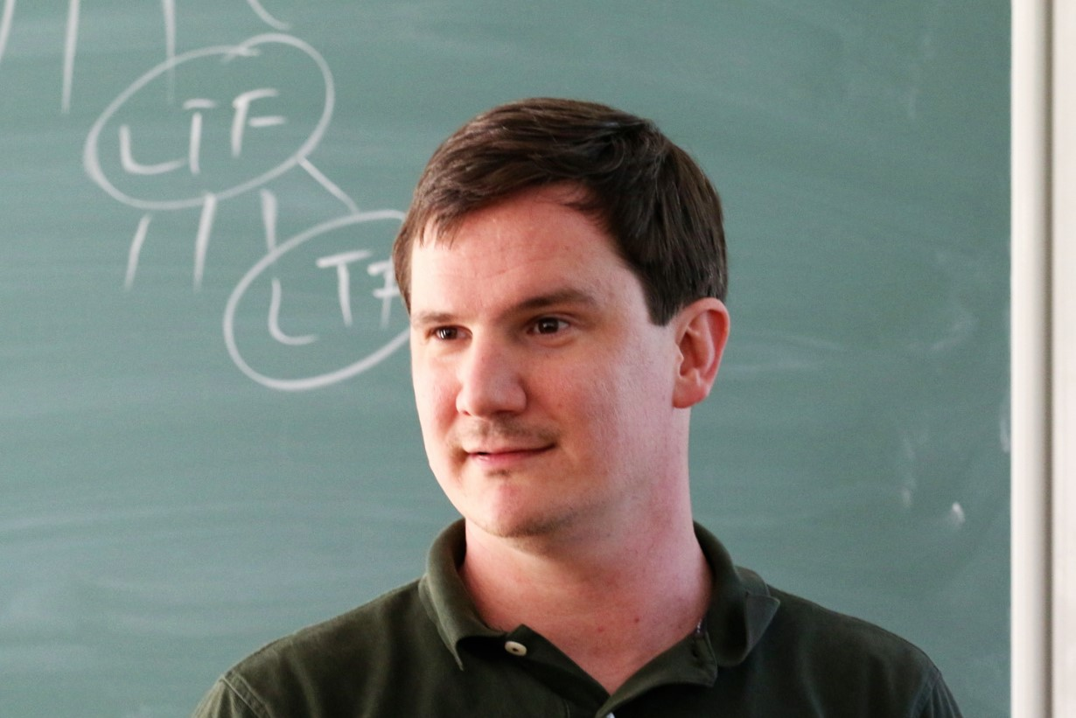

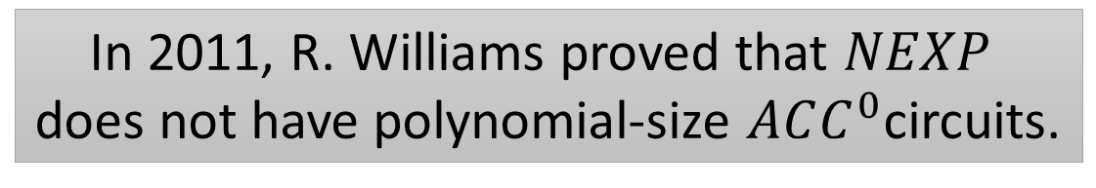
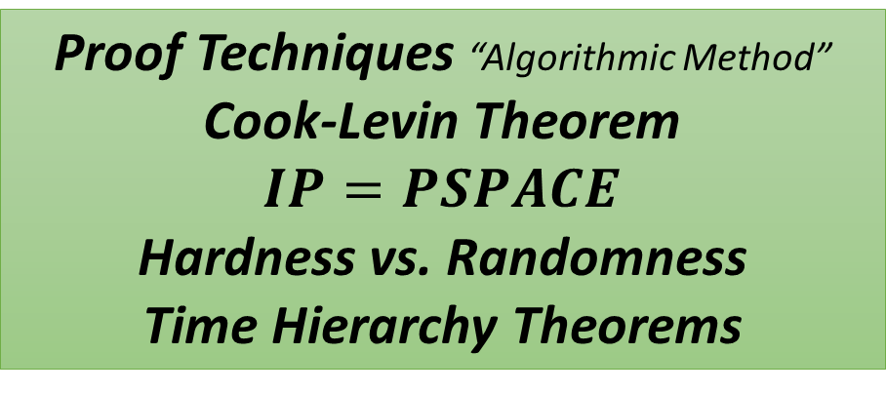
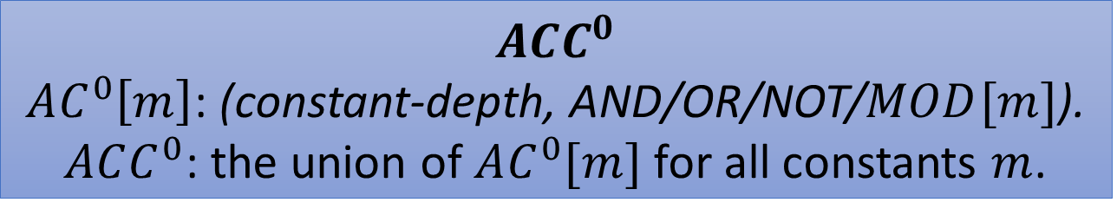
The Circuit Lower Bounds Program for $NP≠P$
NEXP $⊄$ $ACC^{0}$
$$ACC^{0}$$
$AC^{0}\left[m\right]$: (constant-depth, AND/OR/NOT/$MOD[m]$).
$ACC^{0}$: the union of $AC^{0}[m]$ for all constants $m$.
In 2011, R. Williams proved that $NEXP$
does not have polynomial-size $ACC^{0}$circuits.
Theoretical Importance of this result
Crossing all the “barriers”
Relativization
Algebrization
Natural Proofs
Proof Techniques “Algorithmic Method”
Cook-Levin Theorem
$$IP=PSPACE$$
Hardness vs. Randomness
Time Hierarchy Theorems

Slide 9

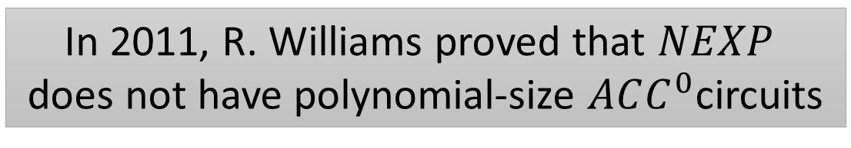
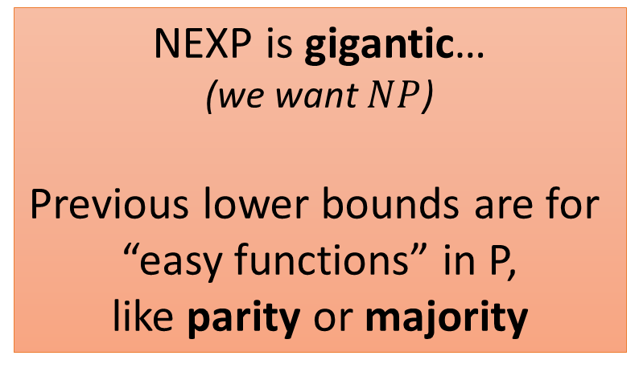
The Circuit Lower Bounds Program for $NP≠P$
NEXP $⊄$ $ACC^{0}$
In 2011, R. Williams proved that $NEXP$
does not have polynomial-size $ACC^{0}$circuits
A Big Breakthrough
Still, it has some drawbacks comparing to previous lower bounds
Only worst-case lower bounds
Previous lower bounds can often be
adapted to the average-case setting
Average-case lower bounds can
have more applications
NEXP is gigantic…
(we want $NP$)
Previous lower bounds are for
“easy functions” in P,
like parity or majority

Slide 10
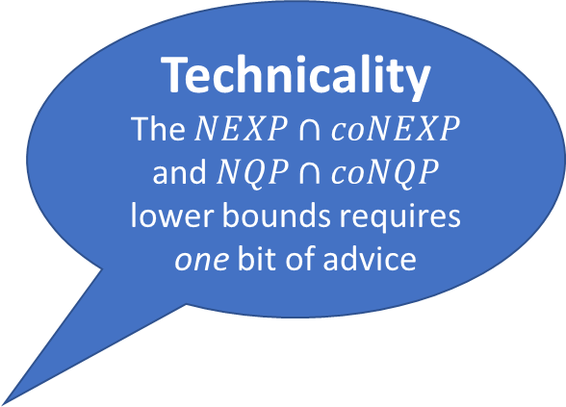

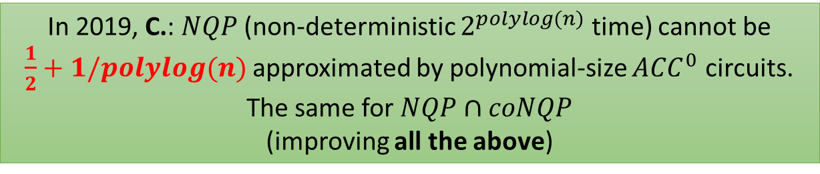
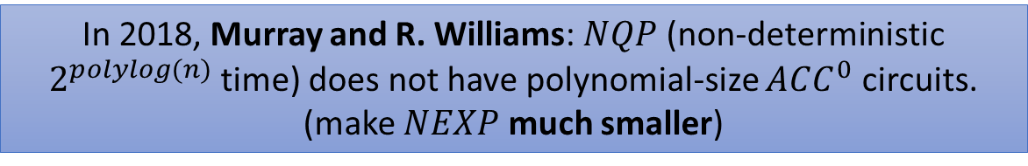
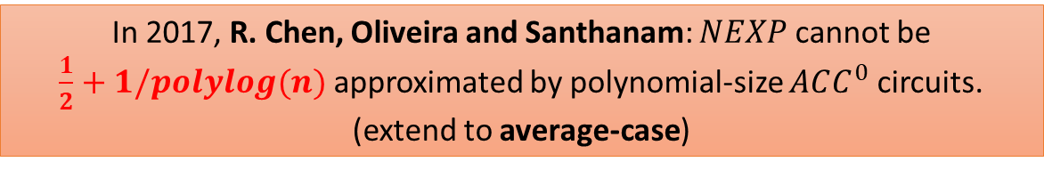
The Circuit Lower Bounds Program for $NP≠P$
Subsequent Developments
In 2012, R. Williams: $NEXP∩coNEXP$
does not have polynomial-size $ACC^{0}$circuits.
(make $NEXP$ a bit smaller)
In 2017, R. Chen, Oliveira and Santhanam: $NEXP$ cannot be
$\frac{1}{2}+1/polylog(n)$ approximated by polynomial-size $ACC^{0}$ circuits.
(extend to average-case)
Can this be improved?
Technicality
The $NEXP∩coNEXP$ and $NQP∩coNQP$ lower bounds requires one bit of advice
In 2018, Murray and R. Williams: $NQP$ (non-deterministic $2^{polylog(n)}$ time) does not have polynomial-size $ACC^{0}$ circuits.
(make $NEXP$ much smaller)
In 2019, C.: $NQP$ (non-deterministic $2^{polylog(n)}$ time) cannot be
$\frac{1}{2}+1/polylog(n)$ approximated by polynomial-size $ACC^{0}$ circuits. The same for $NQP∩coNQP$
(improving all the above)
Notes:
This Chen is not me!

Slide 11
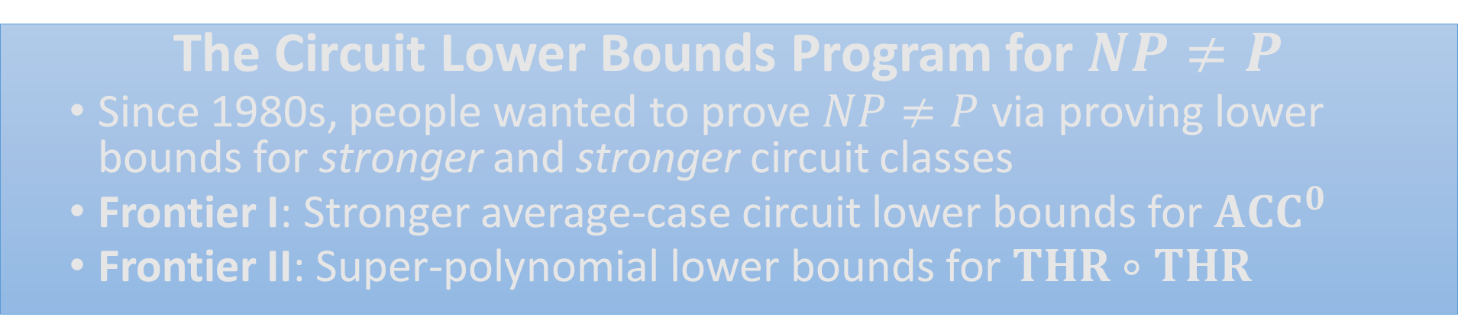
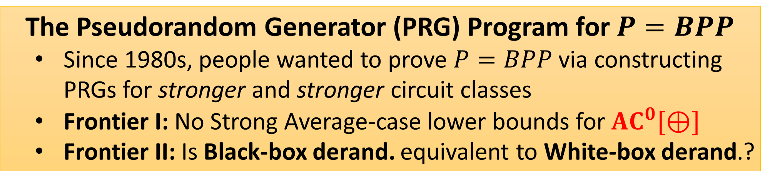
(Oversimplified) History and Motivation
The Circuit Lower Bounds Program for $NP≠P$
  Since 1980s, people wanted to prove $NP≠P$ via proving lower bounds for stronger and stronger circuit classes
  Frontier I: Stronger average-case circuit lower bounds for $ACC^{0}$
  Frontier II: Super-polynomial lower bounds for $THR∘THR$
The Pseudorandom Generator (PRG) Program for $P=BPP$
  Since 1980s, people wanted to prove $P=BPP$ via constructing PRGs for stronger and stronger circuit classes
  Frontier I: No Strong Average-case lower bounds for $AC^{0}[⊕]$
  Frontier II: Is Black-box derand. equivalent to White-box derand.?
Notes:
TODO:dots

Slide 12
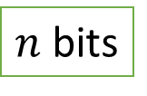
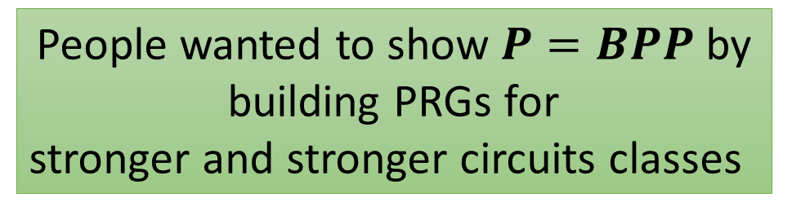

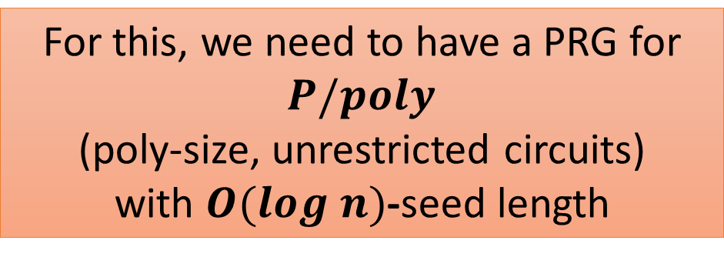

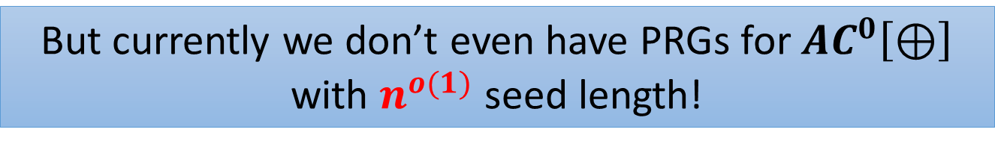
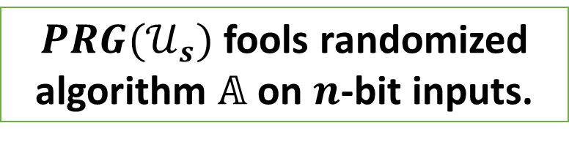
(Oversimplified) History
The Pseudorandom Generator Program for $P=BPP$
$PRG(𝒰_{s})$ fools randomized algorithm $𝔸$ on $n$-bit inputs.
PRG
$s$ bits
$n$ bits
$𝔸$ in $2^{s}$ deterministic time
For this, we need to have a PRG for $P/poly$
(poly-size, unrestricted circuits)
with $O(log n)$-seed length
People wanted to show $P=BPP$ by building PRGs for
stronger and stronger circuits classes
But currently we don’t even have PRGs for $AC^{0}\left[⊕\right]$ with $n^{o(1)}$ seed length!
Notes:
TODO: add the best we have
TODO: ``currently’’ -> ``before our results’’?

Slide 13
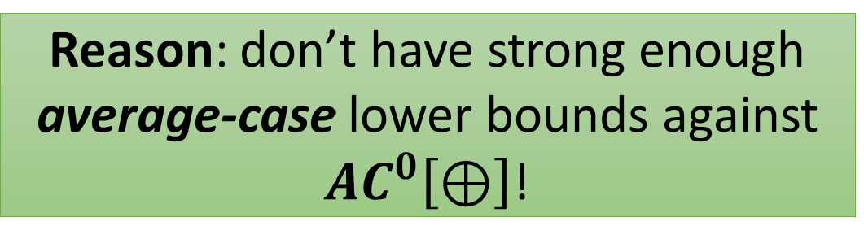

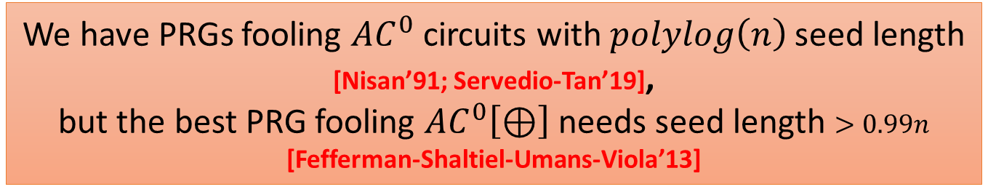
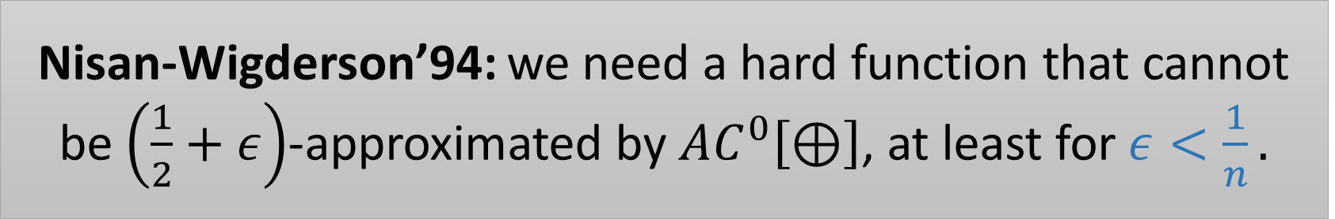
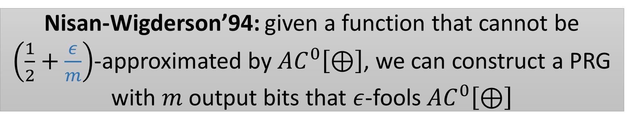
Pseudorandom Generators fooling $AC^{0}\left[⊕\right]$?
The Pseudorandom Generator Program for $P=BPP$
We have PRGs fooling $AC^{0}$ circuits with $polylog\left(n\right)$ seed length [Nisan’91; Servedio-Tan’19],
but the best PRG fooling $AC^{0}\left[⊕\right]$ needs seed length $>0.99n$ [Fefferman-Shaltiel-Umans-Viola’13]
Reason: don’t have strong enough average-case lower bounds against $AC^{0}\left[⊕\right]$!
Nisan-Wigderson’94: we need a hard function that cannot be $\left(\frac{1}{2}+ε\right)$-approximated by $AC^{0}\left[⊕\right]$, at least for $ε<\frac{1}{n}.$
Nisan-Wigderson’94: given a function that cannot be $\left(\frac{1}{2}+\frac{ε}{m}\right)$-approximated by $AC^{0}\left[⊕\right]$, we can construct a PRG with $m$ output bits that $ε$-fools $AC^{0}\left[⊕\right]$

Slide 14
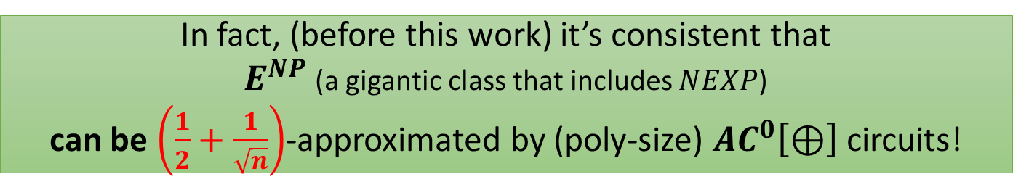


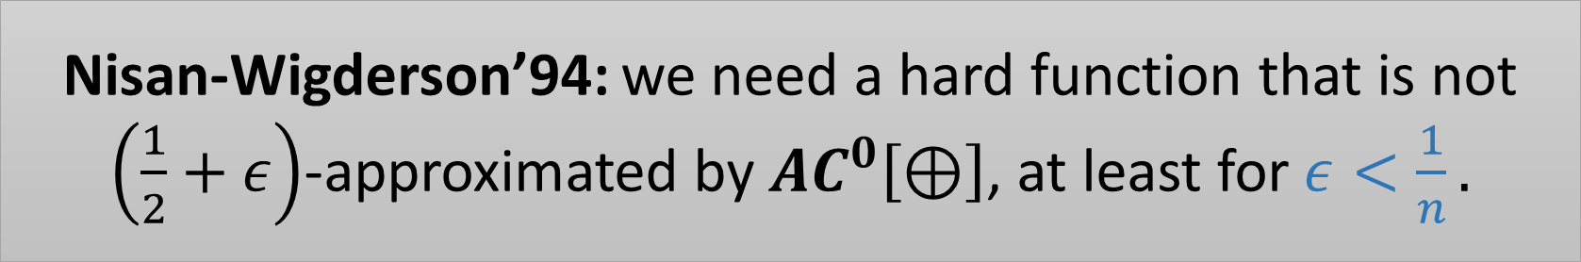

Pseudorandom Generators fooling $AC^{0}\left[⊕\right]$?
The Pseudorandom Generator Program for $P=BPP$
State-of-the-art average-case lower bound:
MAJORITY cannot be $\left(\frac{1}{2}+n^{−0.49}\right)$-approximated by $AC^{0}\left[⊕\right]$ circuits.
This lower bound does not yield PRGs!
In fact, (before this work) it’s consistent that
$E^{NP}$ (a gigantic class that includes $NEXP$)
can be $\left(\frac{1}{2}+\frac{1}{\sqrt{n}}\right)$-approximated by (poly-size) $AC^{0}\left[⊕\right]$ circuits!
It’s also consistent that $E^{NP}$ can be $\left(\frac{1}{2}+\frac{1}{\sqrt{n}}\right)$-approximated by
$\left(\log{n}\right)$-degree $𝔽_{2}$-polynomials.
Nisan-Wigderson’94: we need a hard function that is not $\left(\frac{1}{2}+ε\right)$-approximated by $AC^{0}\left[⊕\right]$, at least for $ε<\frac{1}{n}.$

Slide 15
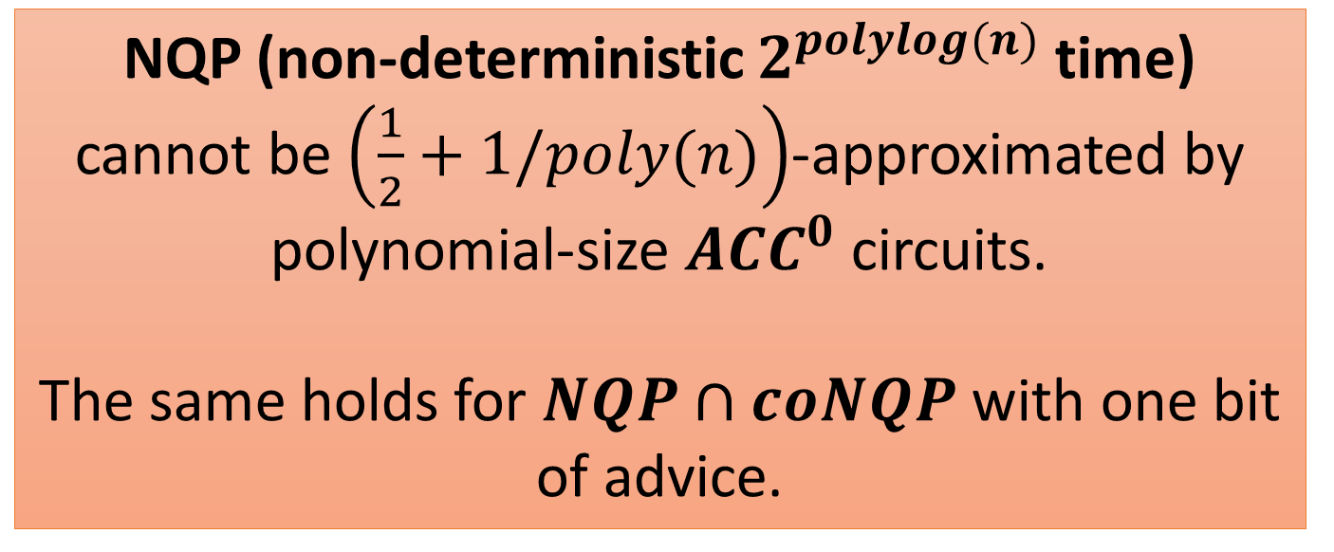
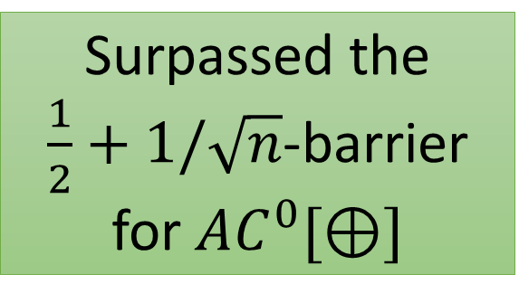
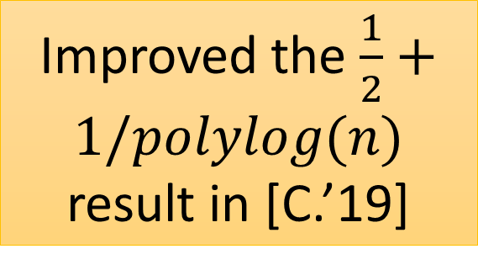

This Work: Strong Average-Case Lower Bounds for $ACC^{0}$
Improved the $\frac{1}{2}+1/polylog(n)$ result in [C.’19]
NQP (non-deterministic $2^{polylog(n)}$ time) cannot be $\left(\frac{1}{2}+1/poly(n)\right)$-approximated by polynomial-size $ACC^{0}$ circuits.
The same holds for $NQP∩coNQP$ with one bit of advice.
Surpassed the
$\frac{1}{2}+1/\sqrt{n}$-barrier for $AC^{0}[⊕]$

Slide 16
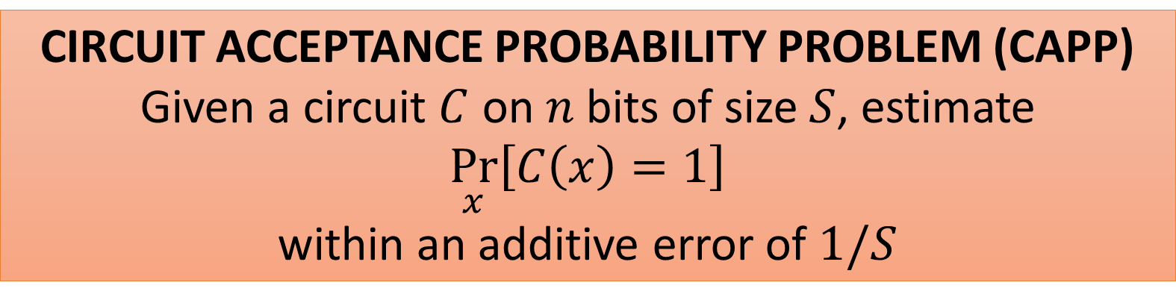
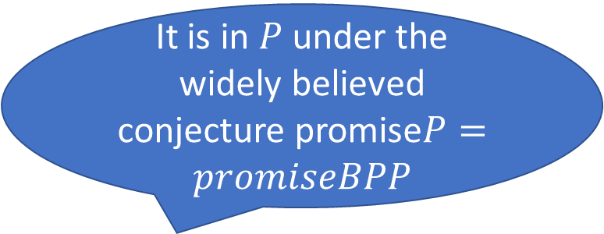
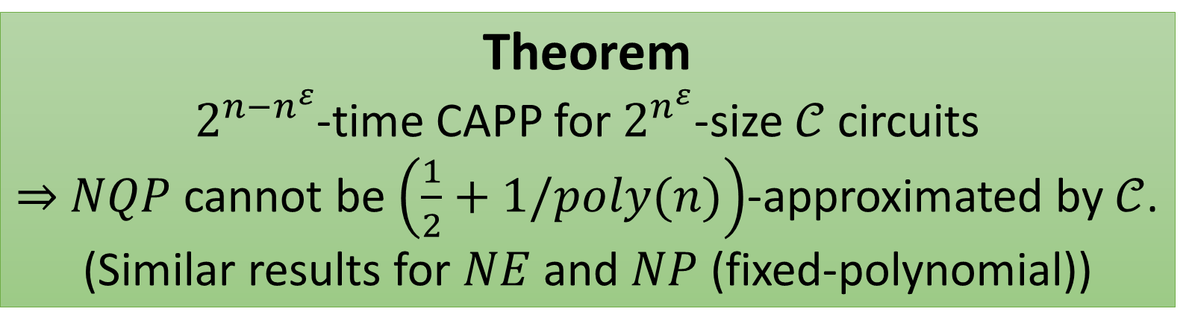
Strong Average-Case Lower Bounds From Non-trivial Derandomization
It is in $P$ under the widely believed conjecture promise$P=promiseBPP$
CIRCUIT ACCEPTANCE PROBABILITY PROBLEM (CAPP)
Given a circuit $C$ on $n$ bits of size $S$, estimate
$$\underset{x}{Pr}\left[C\left(x\right)=1\right]$$
within an additive error of $1/S$
Theorem
$2^{n−n^{ε}}$-time CAPP for $2^{n^{ε}}$-size $𝒞$ circuits
$⇒$ $NQP$ cannot be $\left(\frac{1}{2}+1/poly(n)\right)$-approximated by $𝒞$.
(Similar results for $NE$ and $NP$ (fixed-polynomial))

Slide 17

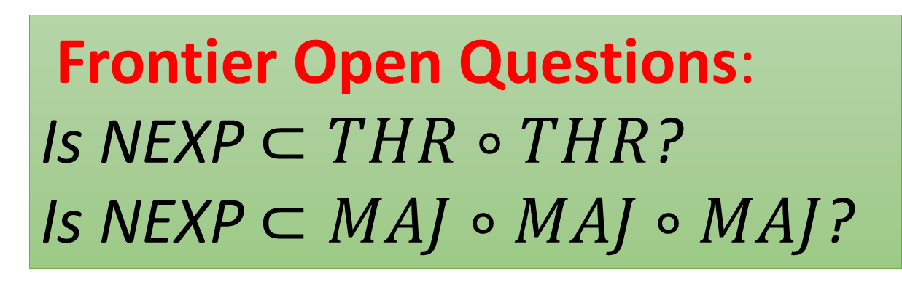
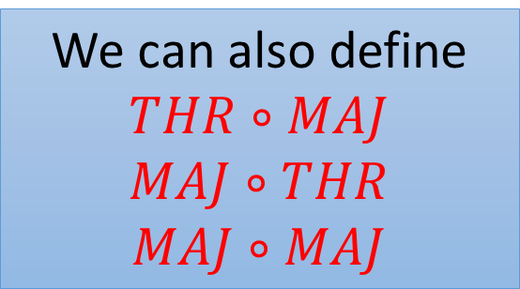

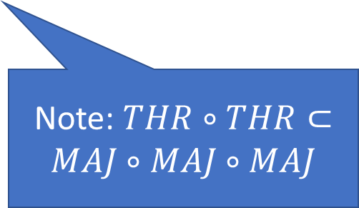
The Circuit Lower Bounds Program for $NP≠P$
THR$∘$THR Circuits
Potential Approach in this Talk!
THR gates : $f\left(x\right)=\left[w⋅x≥t\right]$ $w∈Z^{n}$, $t∈Z$.
Frontier Open Questions:
Is NEXP $⊂THR∘THR$?
Is NEXP $⊂MAJ∘MAJ∘MAJ$?
MAJ gates : when $w_{i}$’s and $t$ are bounded by poly(n).
THR$∘$THR:
We can also define
$$THR∘MAJ$$
$$MAJ∘THR$$
$$MAJ∘MAJ$$
THR
Note: $THR∘THR⊂MAJ∘MAJ∘MAJ$
Exponential Lower Bounds are known!
THR
THR
THR

Slide 18
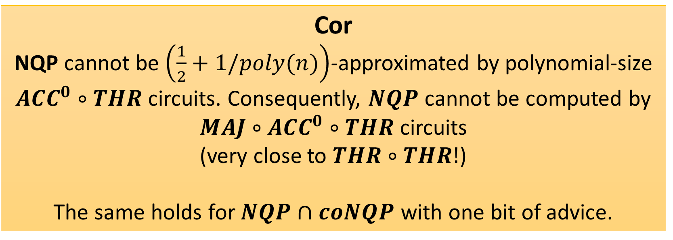
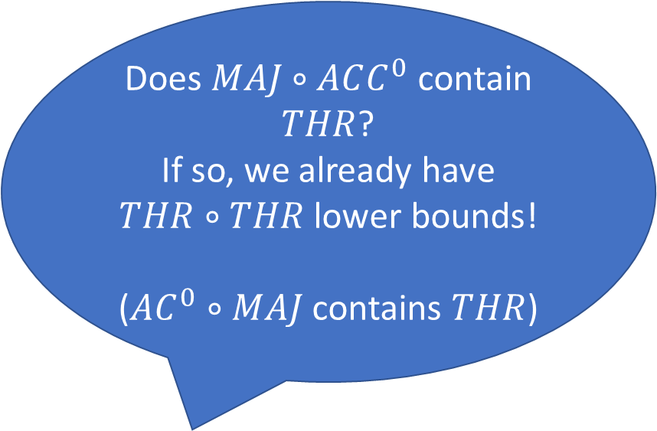
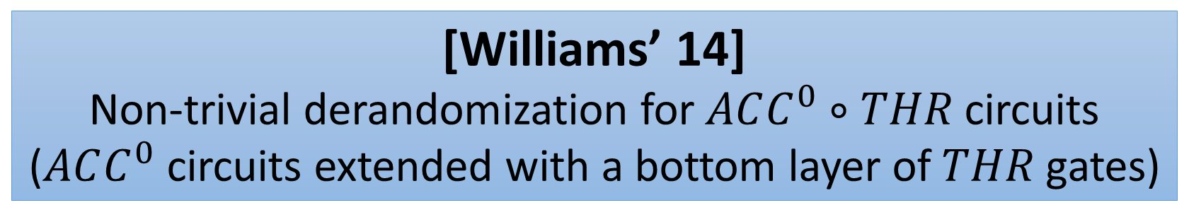

Strong Average-Case Lower Bounds for $ACC^{0}∘THR$
[Williams’ 14]
Non-trivial derandomization for $ACC^{0}∘THR$ circuits
($ACC^{0}$ circuits extended with a bottom layer of $THR$ gates)
Does $MAJ∘ACC^{0}$ contain $THR$?
If so, we already have $THR∘THR$ lower bounds!
($AC^{0}∘MAJ$ contains $THR$)
Cor
NQP cannot be $\left(\frac{1}{2}+1/poly(n)\right)$-approximated by polynomial-size $ACC^{0}∘THR$ circuits. Consequently, $NQP$ cannot be computed by $MAJ∘ACC^{0}∘THR$ circuits
(very close to $THR∘THR!$)
The same holds for $NQP∩coNQP$ with one bit of advice.

Slide 19



Potential Approach to $MAJ∘MAJ∘MAJ$ Lower Bounds
If there is a $2^{n}/n^{ω(1)}$-time derandomization for $MAJ∘MAJ$,
Then NEXP not in $MAJ∘MAJ∘MAJ$.
Can we “mine” any non-trivial derandomization algorithms from the exponential lower bound proofs for $MAJ∘MAJ$ or $THR∘MAJ$?
Would imply NEXP not in $MAJ∘MAJ∘MAJ$!

Slide 20



Black-box and White-box Derandomization
Application
Building PRGs seems hard, so why stick to them?
PRG does not ``look at’’ the given circuit (Black-box derand.)
Maybe looking at the given circuit helps?
    What about “White-box” derandomization?
[Impagliazzo-Kabanets-Wigderson’02]
In certain settings, “Looking into the circuit” does not help for $P/poly$!
Equivalent
sub-exp-time white-box Derandomization of $P/poly$
sub-exp-time black-box Derandomization of $P/poly$
Conditions apply: Infinite-Often, with $n^{ε}$ advice, non-deterministic

Slide 21



Black-box and White-box Derand Equivalence for “All” Circuit Classes
We proved that non-trivial white-box derandomization
Implies strong average-case lower bounds, which further implies PRGs
Some small technical conditions
Corollary
In certain settings, “Looking into the circuit” does not help for ”all” circuit classes $𝒞$!
Equivalent
sub-exp-time white-box Derandomization of $𝒞$
sub-exp-time black-box Derandomization of $𝒞$
Conditions apply: Infinite-Often, with $n^{ε}$ advice, non-deterministic

Slide 22

How this Work relies on recent works
``Almost’’ almost everywhere (a.a.e.) $MA$ circuit lower bounds
[Murray and Williams 2018]
[C. and Williams 2019]
Applying PCP of Proximity to help derandomization
[C. 2019]
Average-case a.a.e. MA circuit lower bounds

Slide 23







Line of works
[Wil’10]
Conditional i.o. NPRG for $P/poly$
[Wil’11]
$2^{n−n^{ε}}$-time algorithm for CAPP of $2^{n−n^{ε}}$-size $ACC^{0}$ circuits
Today’s Plan
Give a roadmap and a perspective on all these works
Based on Circuit Lower Bounds via Derandomization
[Wil’13] ([Wil’11])
Conditional a.e. MA lower bounds, and $NEXP⊄ACC^{0}$.
[MW’18]
a.a.e. MA lower bounds, and
$NQP⊄ACC^{0}$.
[C.W’19]
CAPP for approximate sum of $ACC^{0}$
PCP of Proximity pushing
evaluations to oracles
[C.’19]
Conditional i.o. NPRG for $NC^{1}$
a.a.e. MA average-case lower bounds,
Conditional collapse from $NC^{1}$ to $ACC^{0}$
$NQP$ can’t be $\frac{1}{2}+1/polylog\left(n\right)$ approximated by $ACC^{0}$
[C.R’20]
Conditional i.o. NPRG for $NC^{1}$
Conditional collapse from $NC^{1}$ to approx. sum of $ACC^{0}$
$NQP$ can’t be $\frac{1}{2}+1/poly\left(n\right)$
approximated by $ACC^{0}$
Notes:
Explain what is i.o.
Explain why i.o. Non-deterministic PRG can be used to i.o. derandomize an MA algorithm

Slide 24




Why Average-Case Lower Bounds are Harder?
[MW’18]’s Worst-Case Lower Bound for NQP
Assume $NQP⊂ACC^{0}$
Apply Easy-Witness Lemma,
every $NQP$ verifier has polynomial-size $ACC^{0}$ witnesses
Easy Witness Lemma
$$NQP⊂ACC^{0}$$
$$⇒$$
All verifiers $V$ for $L∈NQP$ have $ACC^{0}$ succinct witnesses.
Use that and a non-trivial algorithm to contradict non-deterministic-time hierarchy!
That is, ``something’’ follows from $NQP⊂ACC^{0}$, which is crucial for the proof

Slide 25




Alternative Plan for Average-case?
Problematic
Assume $NQP$can be approximated by $ACC^{0}$ circuits
Apply Easy-Witness Lemma(?),
every $NQP$ verifier has polynomial-size $ACC^{0}$ witnesses
Can we show an “average-case easy-witness lemma”?
($NQP$ can be approximated by $ACC^{0}$
$⇒NQP$ has $ACC^{0}$ succinct witnesses)
The old proof breaks…
Use that and a non-trivial algorithm to contradict non-deterministic-time hierarchy!
Notes:
TODO: simplify the explanations here

Slide 26




Chen-Oliveira-Santhanam’s approach:
NEXP is average-case hard for $ACC^{0}$
[COS’18]: Well, let us bypass this issue with a big weapon:
Worst-case to Average-case Hardness Amplification
Start with [Wil’14]: $L∈{\left(NEXP∩coNEXP\right)}_{/1}$ is (worst-case) hard for $ACC^{0}$.
Idea: compute the error correcting code of the entire truth-table of $L$,
and make it the truth-table of new language $\tilde{L}$.
Then $\tilde{L}$ is avg-case hard for $ACC^{0}$.
Issue: this requires at least exponential time! Even if $L∈(NQP∩coNQP)$, $\tilde{L}$ will not be in $NQP$ anymore
Notes:
Say some intuition

Slide 27



[COS’18]: NEXP is average-case hard for $ACC^{0}$
However, even for $NE$, [COS’18] can only give
$\frac{1}{2}+n^{−o(1)}$-inapproximability bounds
The complexity of local-list-decoder
If $\tilde{L}$ can be approximated by an $ACC^{0}$ circuit $C$, we can use a local-decoder $D$ to correct the error.
Now $D^{C}$ computes $L$ in the worst case, contradiction!
To obtain a contradiction, we need
$D^{C}$ is still in $ACC^{0}$!
[SV’10, Grinberg-Shaltiel-Viola’18]
If D can correct $\frac{1}{2}−n^{−k}$-error, then $D$ is at least as powerful as majority
Notes:
Say some intuition

Slide 28
Difficulties with previous approaches
That is, we need to prove an average-case lower bound directly,
without going through either
Easy-witness Lemma
(we don’t have that in average case)
Hardness Amplification Reason I
(requires at least exp-time)
Hardness Amplification Reason II
(requires majority in decoder)
So use a more direct approach!
Combining MA lower bounds and (nondeterministic) PRGs
Notes:
Say some intuition
Also talk about Hardness amplification requires majority here?

Slide 29



Circuit Lower Bounds and Derandomization
[BFT ’98] $MA_{EXP}$ is not in P/poly
MA Algorithm
NP with a randomized verifier!
Given an input $x$, guess some witness $y$, toss some coins $r$.
$x∈L⇒∃y\underset{r}{Pr}\left[A\left(x,y,r\right)=1\right]≥2/3$;
$$x∉L⇒∀y\underset{r}{Pr}\left[A\left(x,y,r\right)=1\right]≤1/3$$
.
MATIME[T(n)]: A(x, y, r) runs in T(|x|) time.
$MA$=$MATIME[poly(n)]$
Promise-P = Promise-BPP
$⇒$ $MA_{EXP}=NEXP$, so $NEXP$ not in $P/poly$.
Pessimistic View
Derandomization is hard…
Optimistic View
Let us do derandomization!

Slide 30


How to Derandomize Merlin-Arthur
Merlin-Arthur Algorithm
Given an input $x$, guess some witness $y$, toss some coins $r$.
$x∈L⇒∃y\underset{r}{Pr}\left[A\left(x,y,r\right)=1\right]≥2/3$;
$x∉L⇒∀y\underset{r}{Pr}\left[A\left(x,y,r\right)=1\right]≤1/3$.
Derandomization of Merlin-Arthur
Given $x$, guess $y$, estimate $\underset{r}{Pr}\left[A\left(x,y,r\right)=1\right]$
deterministically, and accept if it’s $>1/2$
If $PromiseBPP=PromiseP$, then $MA=NP$! ($MA_{EXP}$=NEXP as well)

Slide 31




Average-Case?
[Buhrman-Fortnow-Thierauf’98] (adapted)
$MA_{EXP}$ cannot be $\frac{1}{2}+1/poly(n)$-approximated by P/poly.
Case I
If $EXP$ cannot be $\frac{1}{2}+1/poly(n)$-
approximated by $P/poly$. DONE
Case II
Otherwise, using the random-self-reducible EXP-complete language,
$EXP=P/poly$ $⇒$ $MA=EXP$
$$⇒MA_{EXP}=TIME[2^{2^{n}}]⊄P/poly$$
If Promise-BPP = Promise-P, then NEXP = MAEXP,
so NEXP cannot be $\frac{1}{2}+poly(n)$-approximated by P/poly!
Therefore, derandomization directly gives average-case lower bounds!

Slide 32


Circuit Lower Bounds for MA are Known, even for average-case
[Buhrman-Fortnow-Thierauf’98]
$MA_{EXP}$ can’t be $\frac{1}{2}+1/poly(n)$-approximated by P/poly.
[Santhanam’09]
$MA_{/1}$ can’t be $\frac{1}{2}+n^{−k}$-approximated by SIZE[$n^{k}$] for any $k$.

Slide 33



Derandomizing Merlin-Arthur yields Average-Case Circuit Lower Bounds
Derandomization of Merlin-Arthur
Given $x$, guess $y$, estimate $\underset{r}{Pr}\left[A\left(x,y,r\right)=1\right]$
deterministically, and accept if it’s $>1/2$
[Santhanam’09]
$MA_{/1}$ can’t be $\frac{1}{2}+n^{−k}$-approximated by SIZE[$n^{k}$] for any $k$.
If Promise-BPP is in P, then $NP$ can’t be approx. by SIZE[$n^{k}$].
If Promise-BPP is in $TIME[2^{polylog(n)}]$, then NQP can’t be approx. by $P/poly$.
Sad Reality: derandomization is super hard…
Can we relax our condition?

Slide 34



Observation I: NPRG suffices!
MA Algorithm
(NP with a randomized verifier!)
Given an input $x$, guess some witness $y$, toss some coins $r$.
$x∈L⇒∃y\underset{r}{Pr}\left[A\left(x,y,r\right)=1\right]≥2/3$;
$x∉L⇒∀y\underset{r}{Pr}\left[A\left(x,y,r\right)=1\right]≤1/3$.
Nondeterministic PRG
Given input $1^{n}$, guess a witness $w$ first.
either rejects w and STOP,
or takes a seed and computes a PRG
Derandomization of MA with NPRG
We can apply NPRG to derandomize MA to NP!
Given input $x$ ($\left|x\right|=n$), we guess both $y$ and $w$, if NPRG accepts $w$, use it to estimate $\underset{r}{Pr}{[A\left(x,y,r\right)=1]}$! (and accept only if $≥1/2$).
Notes:
Explain what is i.o.
Explain why i.o. Non-deterministic PRG can be used to i.o. derandomize an MA algorithm

Slide 35

Observation II: Conditional Construction suffices!
To show $NQP$ not in $𝓒$
It suffices to prove, assuming $NQP$ in $𝓒$, one can construct a
polylog(n) seed length NPRG.
Notes:
Explain what is i.o.
Explain why i.o. Non-deterministic PRG can be used to i.o. derandomize an MA algorithm

Slide 36



Bootstrapping of Derandomization to NPRG
So, looks like we should have $NQP⊄ACC^{0}$ back in 2011?
How to get it?
conditional NPRG
Circuit Lower Bounds!
[Wil’10] Bootstrapping
$2^{n−n^{ε}}$-time Algorithm for CAPP of $2^{n^{ε}}$ circuits
$⇒polylog(n)$ seed-length NPRG!
[Wil’11]
$2^{n−n^{ε}}$-time algorithm for
CAPP of $2^{n^{ε}}$-size $ACC^{0}$ circuits!
Caveat
1. The resulting NPRG only works infinite-often
2. Bootstrapping only works for general circuits
Notes:
Explain what is i.o.
Explain why i.o. Non-deterministic PRG can be used to i.o. derandomize an MA algorithm

Slide 37



Conditional Construction of NPRG
We only have a
$2^{n−n^{ε}}$-time Algorithm for CAPP of $2^{n^{ε}}$-size $ACC^{0}$ circuits
(the bootstrapping theorem requires such an algorithm for general circuits)
Since we can assume $NQP⊂ACC^{0}$ (for proving worst-case lower bound), $P/poly$ collapses to $ACC^{0}$.
Intuition
Due to the collapse, we can then pretend the $2^{n−n^{ε}}$-time CAPP algorithm works for $2^{n^{ε}}$-size general circuits!
Notes:
Explain what is i.o.
Explain why i.o. Non-deterministic PRG can be used to i.o. derandomize an MA algorithm

Slide 38




Issue: i.o. NPRG vs MA lower bounds
$MA$ not in $SIZE(n^{k})$ says that there the hard language $L$ is not in $SIZE(n^{k})$ on an infinite number of input lengths
What if our infinite-often NPRG does not work for these input lengths?
we need an $MA$ hard language $L$ which is hard on all input lengths (a.e.)!
However, this is an annoying open question.
$$L∈MA$$
$NPRG$ G
☹
☺
Notes:
Explain what is i.o.
Explain why i.o. Non-deterministic PRG can be used to i.o. derandomize an MA algorithm

Slide 39


Partial Solution: Conditional A.E. MA Lower Bounds [Williams 2013], [IKW’02]
Assuming $NEXP⊂P/poly$, $MA=EXP=NEXP$ [IKW’02], and
$QuasiMA=TIME[2^{2^{polylog(n)}}]$ not in P/poly, a.e.
This is viewpoint is mostly from
Natural Proofs versus Derandomization [STOC, 2013]
which is very different from the famous
Non-Uniform ACC Circuit Lower Bounds [CCC, 2011]
Under the assumption we want to disprove
($NEXP⊂ACC^{0}⇒MA=EXP=NEXP$),
We have a.e. MA lower bounds ☺
Unfortunately, this only works for lower bounds against $NEXP$☹
This is the major reason why previous proof only works for NEXP
Notes:
Explain what is i.o.
Explain why i.o. Non-deterministic PRG can be used to i.o. derandomize an MA algorithm

Slide 40


Full Solution: a.a.e. MA Lower Bounds
[Murray-Williams 2018]
Key Observation
Each ``good length’’ of the NPRG can be used to derandomize an interval of input lengths of the MA language
For a $polylog(n)$-seed length NPRG G, the interval could be of quasi-polynomial stretch.
[MW’18] proved such a lower bound
Almost Almost-Everywhere MA lower bounds
Informally, for all $n$, there is $m∈[n,n^{polylog(n)}]$ such that $L$ is hard on input length $m$.
Notes:
Explain what is i.o.
Explain why i.o. Non-deterministic PRG can be used to i.o. derandomize an MA algorithm

Slide 41




[MW’18]: Apply conditional NPRG to derandomize circuit lower bounds for MA
[Wil’10]
$2^{n−n^{ε}}$-time Algorithm for CAPP of $2^{n^{ε}}$ circuits
$⇒polylog(n)$ seed-length NPRG!
[Wil’11]
$2^{n−n^{ε}}$-time algorithm for
CAPP of $2^{n^{ε}}$-size $ACC^{0}$ circuits!
[MW’18]
Almost almost-everywhere
MA circuit lower bounds
Conditional i.o. NPRG
Assuming $NQP⊂ACC^{0}$, polylog(n) seed NPRG for general circuits.
NQP not in $ACC^{0}$!
Notes:
Explain what is i.o.
Explain why i.o. Non-deterministic PRG can be used to i.o. derandomize an MA algorithm

Slide 42


Adaptation to the Average-Case
Worst-Case Lower Bounds
a.a.e. MA lower bounds + conditional i.o. NPRG
Two New Pieces
a.a.e average-case
MA circuit lower bounds
Polylog(n) seed-length conditional NPRG
[C., 2019]
Notes:
Explain what is i.o.
Explain why i.o. Non-deterministic PRG can be used to i.o. derandomize an MA algorithm

Slide 43



Conditional Construction of NPRG: Adapted
[Wil’10]
$2^{n−n^{ε}}$-time Algorithm for CAPP of $2^{n^{ε}}$ circuits
$⇒polylog(n)$ seed-length NPRG!
Bootstrapping only works with $P/poly$
In the worst-case lower bound, we use the assumption $NQP⊂ACC^{0}$, which implies $P/poly$ collapses to $ACC^{0}$, and then we can pretend we have algorithms for $P$/poly.
Solution
Indeed, bootstrapping also works for $NC^{1}$ (circuits of $O(\log{n})$ depth)!
$NQP$ can be approximated by $ACC^{0}$ $⇒$ $NC^{1}$ collapses to $ACC^{0}$
Notes:
Explain what is i.o.
Explain why i.o. Non-deterministic PRG can be used to i.o. derandomize an MA algorithm

Slide 44



[C.’19]’s Approach in Three Steps
Step I: (Conditional Simulation)
Assuming $NQP$ can be $0.99$-approximated by $ACC^{0}$,
$NC^{1}$ can be simulated by $ACC^{0}$.
Step II: (An NPRG for $NC^{1}$)
Since $NC^{1}=ACC^{0}$, now we can pretend we have non-trivial algorithms for $NC^{1}$, use bootstrapping to get polylog(n) seed length NPRG for $NC^{1}.$
Step III: (The Lower Bound)
Prove that there is a language $L$ in $MATIME[2^{polylog(n)}]$ such that $L$ cannot be $\left(\frac{1}{2}+n^{−k}\right)$-approximated by $NC^{1}$. Apply NPRG of Step II to derandomize $L$ in $NQP$. Contradiction!

Slide 45




The Bottleneck of [C.’19]
Step I (?): (Conditional Simulation)
Assuming $NQP$ can be $(\frac{1}{2}+n^{−k})$-approximated by $ACC^{0}$, $NC^{1}$ can be simulated by $ACC^{0}$?
Now, suppose we want to prove $NQP$ cannot be $\left(\frac{1}{2}+n^{−k}\right)$-approximated by $ACC^{0}$ instead, which steps break?
not affected!
Step II: (An NPRG for $NC^{1}$)
Since $NC^{1}=ACC^{0}$, now we can pretend we have non-trivial algorithms for $NC^{1}$, use bootstrapping to get polylog(n) seed length NPRG for $NC^{1}.$
The problem is Step I!
Step III: (The Lower Bound)
Prove that there is a language $L$ in $MAQP$ such that $L$ cannot be $\left(\frac{1}{2}+n^{−k}\right)$-approximated by $NC^{1}$. Apply NPRG of Step II to derandomize $L$ in $NQP$. Contradiction!
Notes:
Recall Step I when the black box pop up

Slide 46


Collapse Theorem
The Question
Assuming $NQP$ can be $\left(\frac{1}{2}+ε\right)$-approximated by $ACC^{0}$, how do we show a collapse from $NC^{1}$ to $ACC^{0}$?
Idea: Random Self-Reducibility
Consider a random self-reducible $NC^{1}$-complete language $L$. That is, there is an error corrector $D$ such that, if $C$ computes $L$ on a $\left(\frac{1}{2}+ε\right)$-fraction of inputs, then $D^{C}$ computes $L$ exactly.

Slide 47



The Collapse Theorem in [C.’19]
The Question
Assuming $NQP$ can be $0.99$-approximated by $ACC^{0}$,
how do we show a collapse from $NC^{1}$ to $ACC^{0}$?
Error Correction in $AC^{0}$
There is an $NC^{1}$-complete language $L$ with
an $AC^{0}$ error corrector $D$, such that if $L$ can be $0.99$-approximated by $C$, then $D^{C}$ computes $L$ exactly.
If $L$ can be $0.99$-approximated by $ACC^{0}$.
Then $NC^{1}$ collapses to $ACC^{0}$.

Slide 48




The Key Issue on Improving [C.’19]
The Updated Question
Assuming $NQP$ can be $\left(\frac{1}{2}+n^{−k}\right)$-approximated by $ACC^{0}$, how do we show a collapse from $NC^{1}$ to $ACC^{0}$?
Circuit Complexity of Error Correction
Now we need an error corrector corrects $\frac{1}{2}−n^{−k}$ error.
Typically, such an error corrector requires MAJORITY.
We don’t know how to do circuit-analysis on $MAJ∘ACC^{0}$ ☹
If $L$ can be $\left(\frac{1}{2}+n^{−k}\right)$-approximated by $ACC^{0}$.
Then $NC^{1}$ collapses to $MAJ∘ACC^{0}$.
Notes:
Maybe say a little bit more on ???
Circuit Complexity of Error Correction?

Slide 49














Approximate Sum
Let $𝒞$ be a circuit class. A Linear Sum of $𝒞$ is
$$L=α_{1}⋅C_{1}+α_{2}⋅C_{2}+…+α_{m}⋅C_{m}$$
where $α_{i}∈ℝ$, and $C_{i}∈𝒞$.
$$\left[−ε,ε\right]$$
if $F\left(x\right)=0$
$$\left[1−ε,1+ε\right]$$
if$F\left(x\right)=1$
We say $F:{\left\{0,1\right\}}^{n}→\{0,1\}$ is an approximate (linear) sum of $𝒞$, if there is an $L$ as above such that
$\left|L\left(x\right)−F\left(x\right)\right|≤ε$ for all $x$.
$$∑$$
$$α_{1}$$
$$α_{2}$$
$$⋯$$
$$α_{m}$$
$$C_{1}$$
$$C_{2}$$
$$⋯$$
$$C_{m}$$
For example, a function $F:{\left\{0,1\right\}}^{n}→\{0,1\}$, has approximate degree $d$, iff it is an approximate linear sum of $AND$ functions on $d$ bits.
Notes:
Cite the relevant paper
Yellow part: Cor
Maybe write the Lemma on the blackboard, so that people will understand.

Slide 50


Error Correction with Approximate Sum
Lemma
There is an $NC^{1}$-hard language with an approximate sum error corrector!
(From Cryptography in $NC^{0}$
[Applebaum-Ishai-Kushilevitz])
Cor
If $L$ can be $\left(\frac{1}{2}+n^{−k}\right)$-approximated by $ACC^{0}.$
Then $NC^{1}$ collapses to Approximate Sum of $ACC^{0}$
Notes:
Cite the relevant paper
Yellow part: Cor
Maybe write the Lemma on the blackboard, so that people will understand.

Slide 51



Why is Approximate Sum better than MAJ?
With this observation
[C.-Williams]:
nontrivial $\#SAT$ algorithm for $ACC^{0}$
$⇒$
nontrivial derand. of approximate sum of $ACC^{0}$ $⇒$
$NQP$ cannot be computed by an approximate sum of $ACC^{0}$
Approximate Sum preserves algorithms!
Given an $ε$-approximate linear sum of $𝒞$ circuits
$$L=∑α_{i}⋅C_{i}$$
for a Boolean function $F$,
$𝔼\left[L\left(x\right)\right]=∑α_{i}⋅𝔼[C_{i}(x)]$ is $ε$-close to $𝔼[F(x)]$.
That is, faster algorithms for computing $𝔼[C_{i}(x)]$ implies faster algorithms for estimating $𝔼\left[F\left(x\right)\right].$

Slide 52
Technical ingredients from Crypto in $NC^{0}$
Only need to know that $⊕L$ is between $NC^{1}$ and $P$
There are two $⊕L$-complete languages $A,B$ such that
$A$ has a single-query randomized reduction to $B$,
where the queried input to $B$ distributes uniformly.
The Randomized Reduction
On an input $x∈^{?}A$:
Output an input $y∈^{?}B$ and a bit $b$
$y=y(x,r)$ is uniformly distributed
$b=b(x,r)$ indicates whether we should flip the answer, i.e. $A\left(x\right)=B\left(y\right) XOR b$
Moreover, both y and b are projections of $x$ when $r$ is fixed.
rand.
reduction
$$y$$
$$B$$
$$B(y)$$
XOR
$$x$$
$$A(x)$$
$$b$$
Notes:
mention that both reductions are “easy” in the sense that they are projections.
(two reductions: A,B are complete for parity L, and A reduces to B)
Need to edit this slide

Slide 53

Error Correction with Approximate Sum
rand.
reduction
$$y$$
$$B$$
$$B(y)$$
XOR
$$x$$
$$A(x)$$
$$b$$
For all $x,r$, $A\left(x\right)=B\left(y\left(x,r\right)\right)⊕b(x,r)$
If there is an $ACC^{0}$ circuit $D$ that $\left(\frac{1}{2}+ε\right)$-approximates $B.$
$E\left(x,r\right)≔D\left(y\left(x,r\right)\right)⊕b(x,r)$.
$E\left(x,r\right)=A(x)$ if and only if $D\left(y\left(x,r\right)\right)=B(y(x,r))$.
$$∀x,\underset{r}{Pr}\left[E\left(x,r\right)=A\left(x\right)\right]=\underset{r}{Pr}[D\left(y\left(x,r\right)\right)=B(y(x,r))] =\frac{1}{2}+ε$$
Independent of $x$!
Notes:
The “B gate” becomes blue; think of it gets corrupted and is only correct wp ½+eps;
It’s crucial that the “>=“ sign is actually an “=“ sign
Need to edit thisslide

Slide 54

Error Correction with Approximate Sum
$$∀x,\underset{r}{Pr}\left[E\left(x,r\right)=A\left(x\right)\right]=\frac{1}{2}+ε$$
The idea: take $t=poly(n,1/ε)$ i.i.d. samples $r_{1},r_{2},…,r_{t}$ and take average.
$$\frac{1}{t}⋅\sum_{i=1}^{t}{E(x,r_{i})}$$
If $A\left(x\right)=0$, then the expected average is $\frac{1}{2}−ε$
If $A\left(x\right)=1$, then the expected average is $\frac{1}{2}+ε$
If $A\left(x\right)=0$, then average $∈\left(\frac{1}{2}−1.01ε,\frac{1}{2}−0.99ε\right)$
If $A\left(x\right)=1$, then average $∈\left(\frac{1}{2}+0.99ε,\frac{1}{2}+1.01ε\right)$
If $B$ can be $\left(\frac{1}{2}+n^{−k}\right)$-approximated by $ACC^{0}$,
Then (as $A$ is $NC^{1}$-hard), $NC^{1}$ collapses to Approximate Sum of $ACC^{0}$
Chernoff bound $⇒$ when $t=poly(n,1/ε)$, actual average is within expected average $±0.01ε$ whp
Use scaling to make a valid approx. sum circuit
Notes:
Need to edit this slide

Slide 55




A quick proof of $NQP$ not in $MAJ∘ACC^{0}$
1. If $NQP$ can be $\left(\frac{1}{2}+n^{−k}\right)$-approximated by $ACC^{0}$, then $NC^{1}$ collapses to approximate sum of $ACC^{0}$.
2. [C. and Williams, 2019]: $NQP$ is not in approximate sum of $ACC^{0}$. Hence, $NQP$ is not in $NC^{1}$ (also not in $MAJ∘ACC^{0}$).
3. If $NQP$ cannot be $\left(\frac{1}{2}+n^{−k}\right)$-approximated by $ACC^{0}$, then $NQP$ cannot be computed by $MAJ∘ACC^{0}$.
(The Discriminator Lemma)
Notes:
Should write the majority of ACC lower bound…

Slide 56




Towards NQP Average-case Lower Bounds Updated Three Steps
Step I’: (Conditional Simulation)
Assuming $NQP$ can be $\left(\frac{1}{2}+n^{−k}\right)$-approximated by $ACC^{0}$, $NC^{1}$ can be simulated by an approximate sum of $ACC^{0}$.
Involves use of PCP of Proximity!
See the paper!
Step II’: (An NPRG for $NC^{1}$)
Following Step I’, now we can pretend we have non-trivial algorithms for $NC^{1}$, use bootstrapping to get polylog(n) seed length NPRG for $NC^{1}.$
Step III’: (The Lower Bound)
Prove that there is a language $L$ in $MATIME[2^{polylog(n)}]$ such that $L$ cannot be $\left(\frac{1}{2}+n^{−k}\right)$-approximated by $NC^{1}$. Apply NPRG of Step II’ to derandomize $L$ in $NQP$. Contradiction!
Notes:
It is clearly to say NC^1 can be simulated by xyz

Slide 57


Conclusion
(Technical Take-home Message)
Approximate Linear Sum is Both Weak and Strong
Weak: Non-trivial Derand of $𝒞$ $⇒$ Non-trivial Derand of Approx. Sum of $𝒞$ (Preserve Algorithms)
Strong: Can do non-trivial error corrections!
(Conceptual Take-home Message)
Algorithms for $𝒞$ (a weaker class) can indeed imply lower bounds for $MAJ∘𝒞$ (a stronger class)!
Notes:
It is clearly to say NC^1 can be simulated by xyz

Slide 58








Extending the Conceptual Take-home Message
Open Questions
Non-trivial
Lower Bounds for
We showed
CAPP for $𝒞$
$$MAJ∘𝒞$$
Conjectured by [Vyas and Williams]
Weak
Strong
?
#SAT for $𝒞$
$$SYM∘𝒞$$
?
Next Step?
SAT for $𝒞$
$$OR∘𝒞$$
?
#SAT for $𝒞$
$$THR∘𝒞$$
Notes:
It is clearly to say NC^1 can be simulated by xyz

Slide 59

Extending the Technical Take-home Message
Open Questions
What else can we do with approximate sum?
Can we apply this to build a deterministic PRG for $AC^{0}[⊕]$? (what about P-uniform $AC^{0}[⊕]$ circuits?)
Is it possible to do hardness amplification for any function with an approximate sum error corrector?
Interestingly, Levin’s proof of XOR Lemma uses approximate linear sum, but does not seem to give an approximate sum error corrector
Notes:
It is clearly to say NC^1 can be simulated by xyz

Slide 60


Open Questions: Reminder
If there is a $2^{n}/n^{ω(1)}$-time CAPP algorithm for $MAJ∘MAJ$,
Then NEXP not in $MAJ∘MAJ∘MAJ$.
Can we “mine” any non-trivial CAPP algorithm from the exponential lower bound proofs for $MAJ∘MAJ$ or $THR∘MAJ$?
Would imply NEXP not in $MAJ∘MAJ∘MAJ$!

Slide 61
Thanks! Any Questions?
Thanks Hanlin Ren for making part of the slides ☺

Slide 62



Issue: i.o. NPRG vs MA lower bounds
It seems we need an $MA$ hard language $L$ which is hard on all input lengths (a.e.)
However, this is a super annoying open question.
However, it could be the case that
$Σ_{2}P$ has linear-size circuits
on infinite input lengths.
[Kannan’82]
$Σ_{2}P$ not in $SIZE\left[n^{k}\right]$ for all $k$
i.o. => a.e.: Long standing Open Problem!
Notes:
Explain what is i.o.
Explain why i.o. Non-deterministic PRG can be used to i.o. derandomize an MA algorithm

Slide 63


Issue: i.o. NPRG vs MA lower bounds
Okay, maybe we can try to strength the NPRG so that it works for all input lengths?
The Key ingredient in the bootstrapping
NTIME Hierarchy Theorem
Okay, it seems we must turn one of the “i.o.” to “a.e.”,
but both are long-standing open problems ☹
[SFM’78, Zak’83]
$NTIME[2^{n}]$ not in $NTIME\left[2^{n}/n\right]$
However, it could be the case that
$NTIME\left[2^{n}\right]⊂i.o.NP$
i.o. => a.e.: Long standing Open Problem!
Notes:
Explain what is i.o.
Explain why i.o. Non-deterministic PRG can be used to i.o. derandomize an MA algorithm

